Slide 1
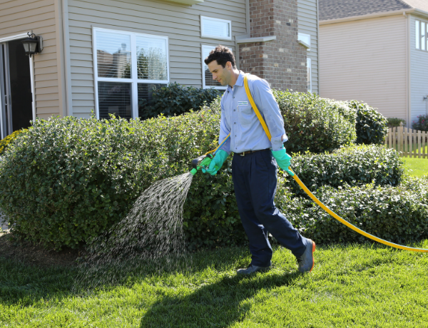
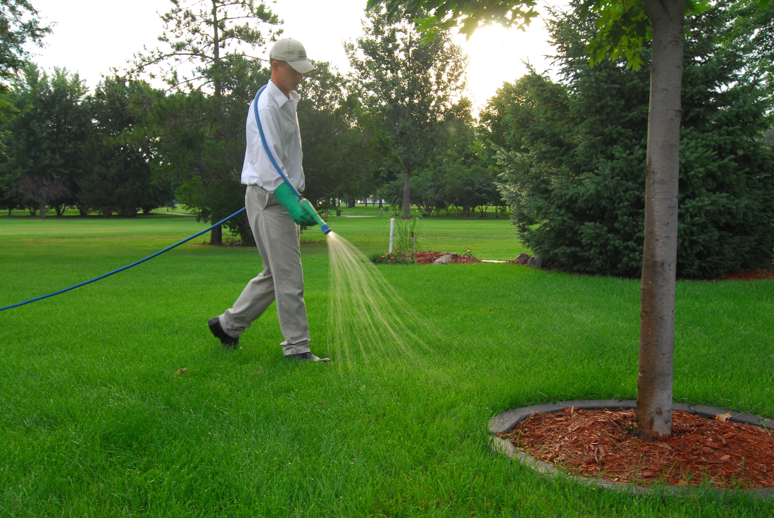
Sensitivity Analysis and Model Evaluation of Bifenthrin Surface Water Concentrations from California Urban Runoff
Emma Chelsvigª, Frederick Ayiviª, Yuzhou Luo^{b}, Debra Denton^{c}, Ann Pitchford^{d}, Sandy Raimondo^{e}, Donald Ebert^{e}, S. Thomas Purucker^{e}, Yongping Yuan^{e}
ªOak Ridge Institute of Science and Engineering (Chelsvig.Emma@epa.gov, frederickayivi@gmail.com)
^{b}California Department of Pesticide Regulation (Yuzhou.Luo@cdpr.ca.gov)
^{c}U.S. Environmental Protection Agency Region 9 (Denton.Debra@epa.gov)
^{d}Retiree, previously U.S. Environmental Protection Agency, Office of Research and Development (pitchford3@cox.net)
^{e}U.S. Environmental Protection Agency, Office of Research and Development (Raimondo.Sandy@epa.gov, Ebert.Donald@epa.gov, Purucker.Tom@epa.gov, Yuan.Yongping@epa.gov)

Slide 2
Goals
Employ deterministic and probabilistic approaches with PWC to simulate bifenthrin concentration in urban runoff
Identify sensitive inputs with respect to model output variability

Slide 3

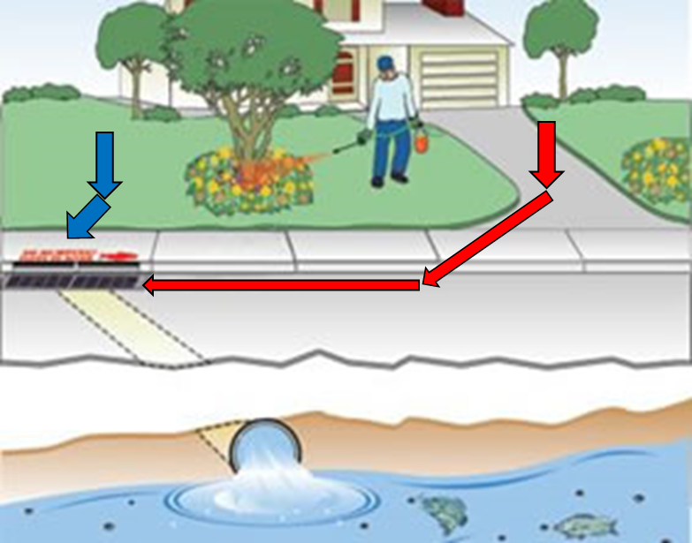
Study Overview
Sacramento-San Joaquin River Delta
Habitat for fish and invertebrate species
Experiencing habitat loss due to pyrethroid use and its associated pollution
Bifenthrin
Pyrethroid; toxic to Delta species
Used by professional pest control applicators for landscape application or as perimeter treatments to structures
Considerable amount in urban runoff after rain events
Use exposure models (ex., PWC)
Rain

Slide 4
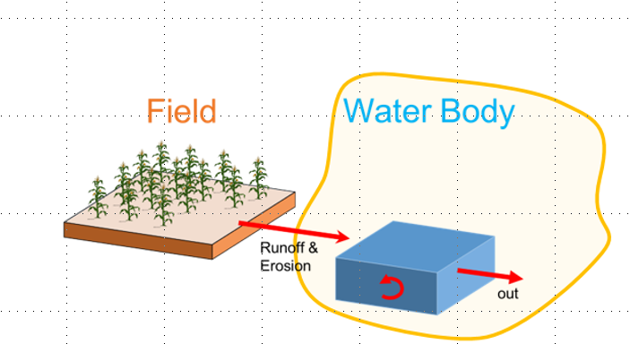
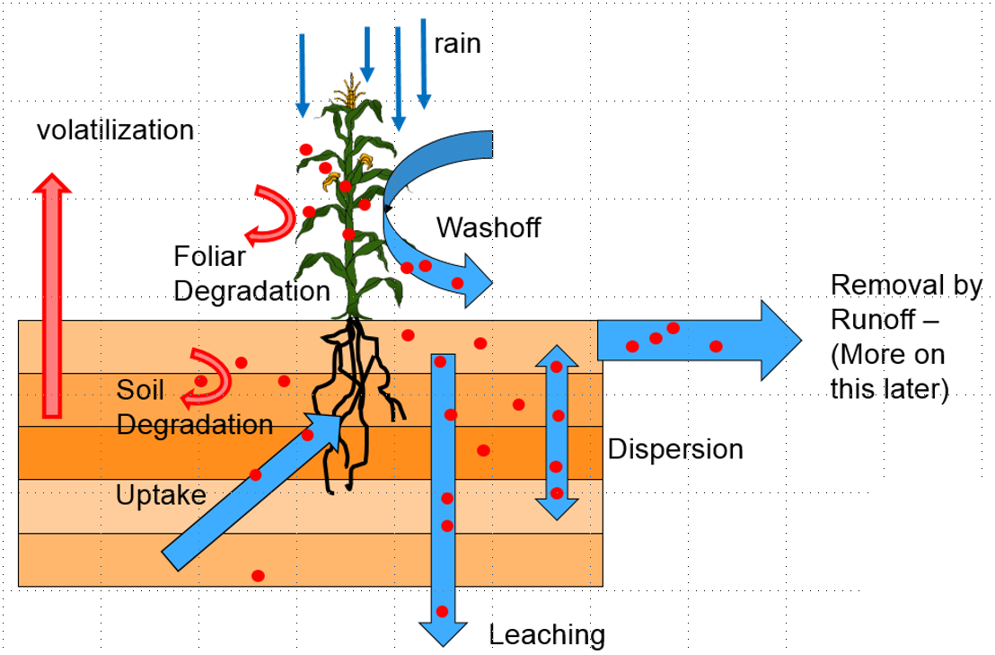
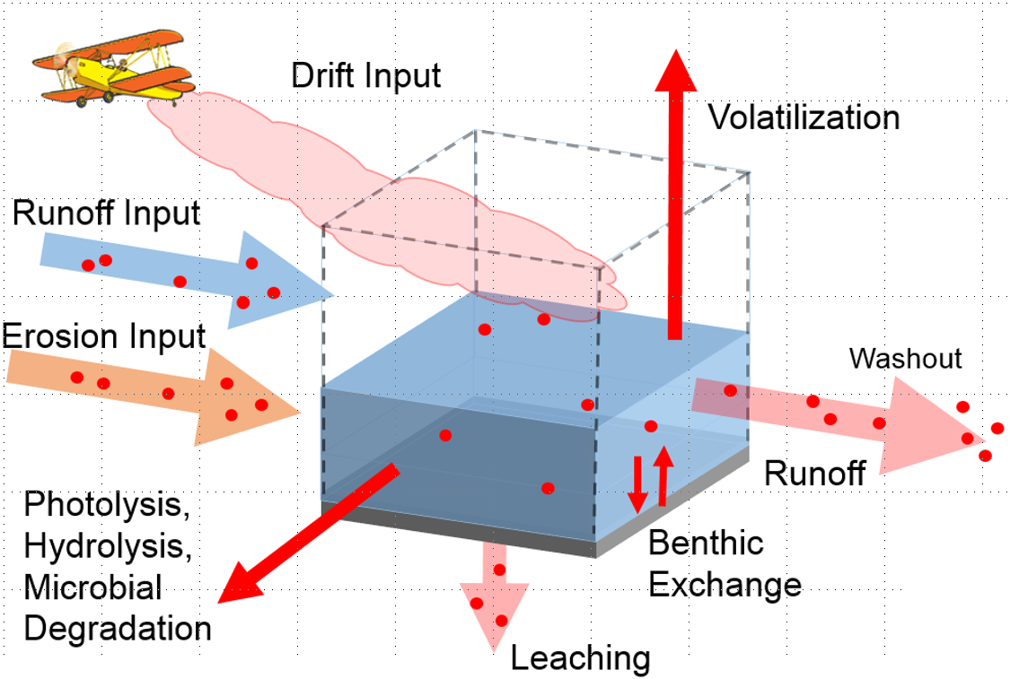
PWC
US EPA Office of Pesticide Program
Simulates pesticide concentration in surface water
Pesticide Root Zone Model (PRZM)
Variable Volume Waterbody Model (VVWM)
Site-specific inputs
PRZM
VVWM

Slide 5
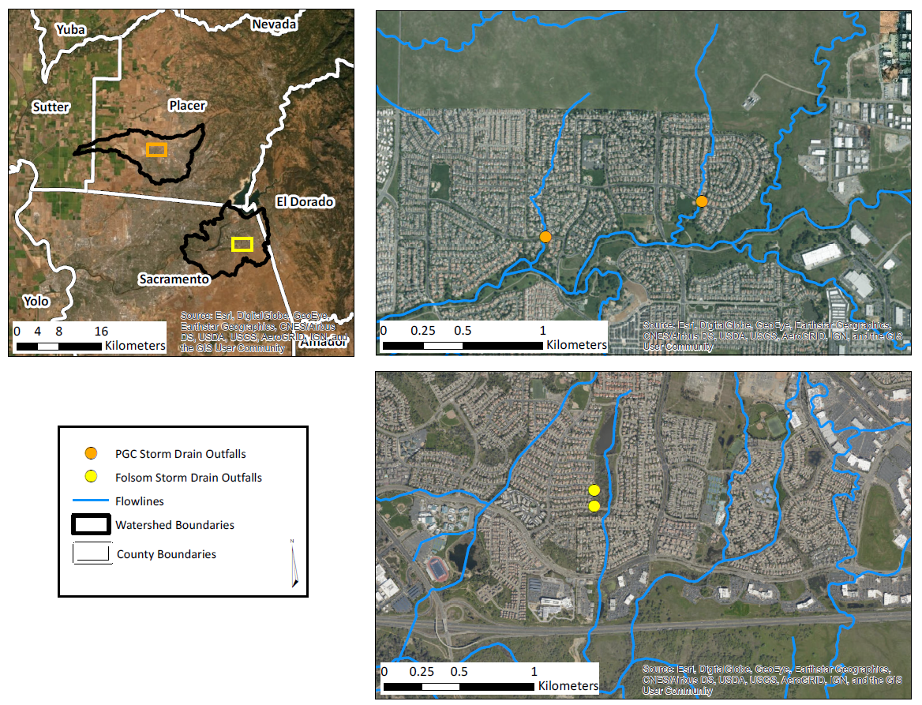
Site Overview

Slide 6
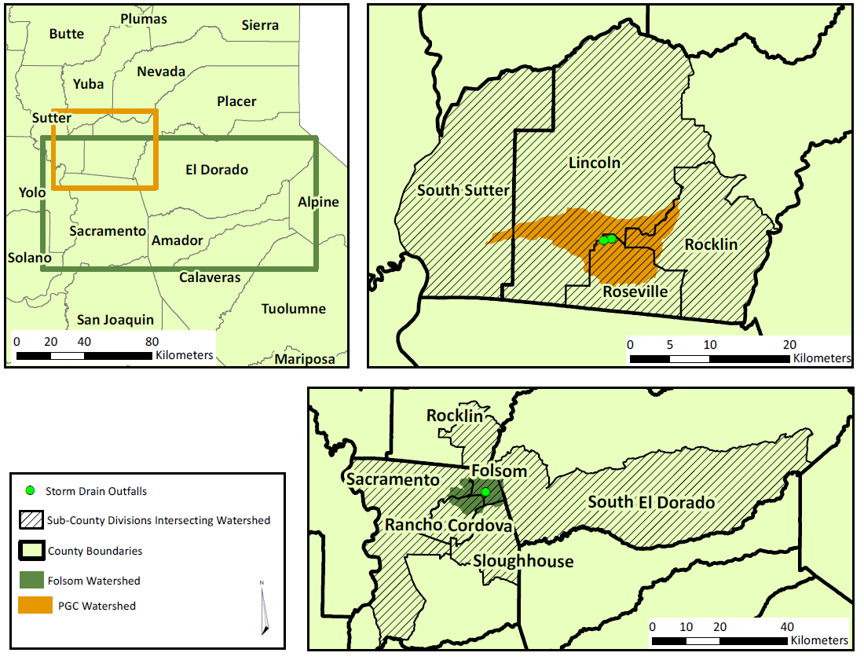
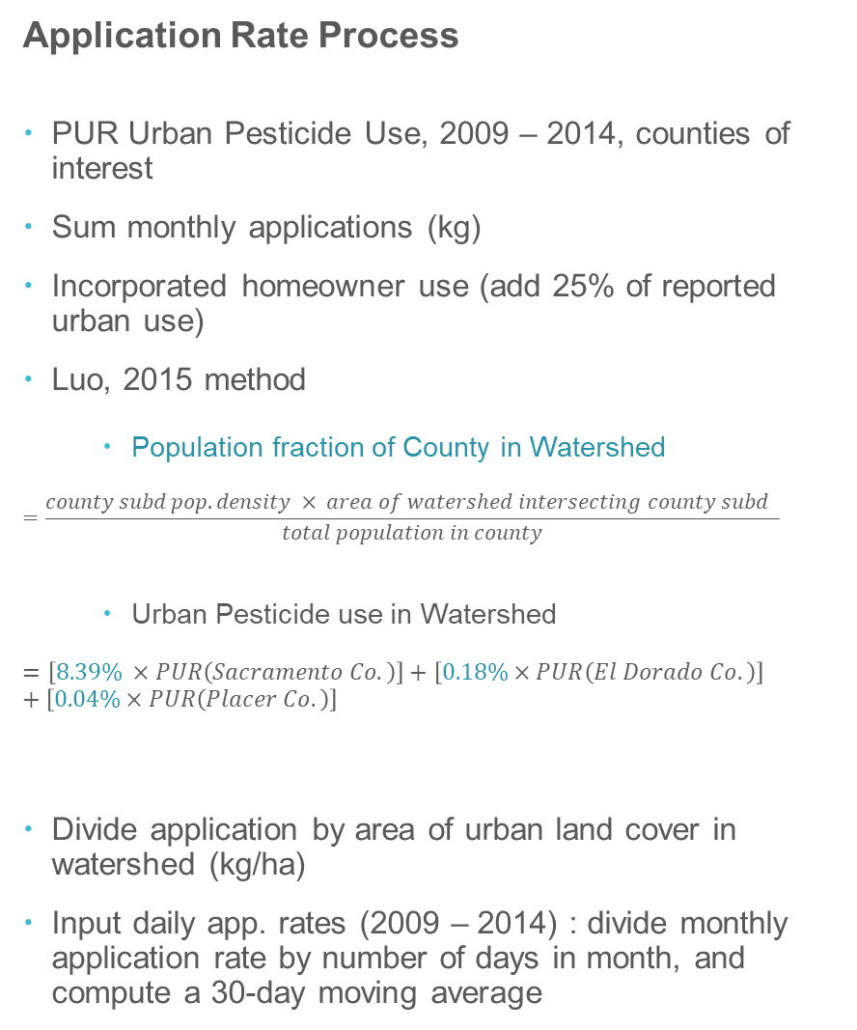
Application Rate Process
PUR Urban Pesticide Use, 2009 – 2014, counties of interest
Sum monthly applications (kg)
Incorporated homeowner use (add 25% of reported urban use)
Luo, 2015 method
Population fraction of County in Watershed
$$=\frac{county subd pop. density × area of watershed intersecting county subd }{total population in county}$$
Urban Pesticide use in Watershed
$=\left[8.39\% ×PUR\left(Sacramento Co.\right)\right]+\left[0.18\%×PUR\left(El Dorado Co.\right)\right]$ $+\left[0.04\%×PUR\left(Placer Co.\right)\right]$
Divide application by area of urban land cover in watershed (kg/ha)
Input daily app. rates (2009 – 2014) : divide monthly application rate by number of days in month, and compute a 30-day moving average

Slide 7
Deterministic Model setup
Single value (conservative estimate) for all input parameters
*.wea weather file (Fry et al., 2016)
One weather station assigned to each storm drain site based on nearest distance between storm drain and grid centroid
Precipitation, Evapotranspiration, Temperature, Wind Speed, Solar Radiation
2008 – 2014
PUR monthly application rates (previous slide)

Slide 8
Probabilistic Model setup
03_write_update_run_pwc.R
lhs_input_ranges.csv
PRZM5.exe
*.wea
06a_pcc_computation_daily.R
06b_pcc_computation_max.R
update
PRZM5.inp
copy
run PRZM
05_write_output_into_df.R
Compute PCC (daily and max)
02_lhs_parameterization.R
Create time array
Store outputs as time series (*.RData, *.csv)
Conduct Latin Hypercube sampling for each parameter
Create input data frame and store inputs (5000 values for each parameter)
*.zts
*.prn
04_write_update_vvwm.R
VVWM.exe
07a_pcc_graphics_daily.R
07a2_pcc_graphics_daily.R
07b_pcc_graphics_max.R
07c_percentile_graphics.R
update
copy
run VVWM
vvwmTransfer.txt
Create PCC graphics
Create percentiles plots
*.csv
*.txt

Slide 9
Percentile Plots (water column)

Slide 10
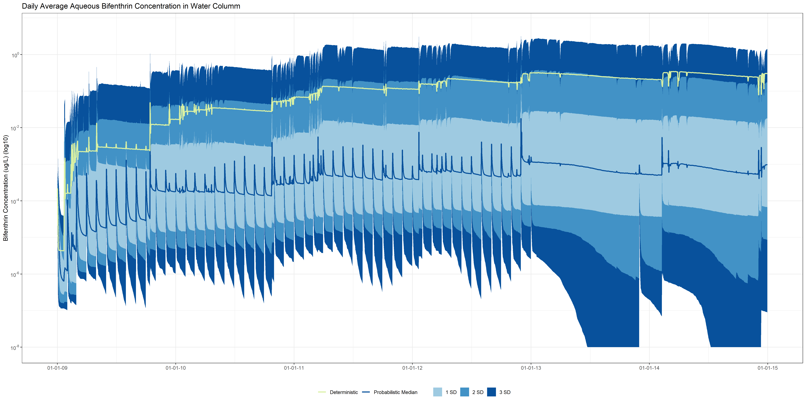
Results
FOL002

Slide 11
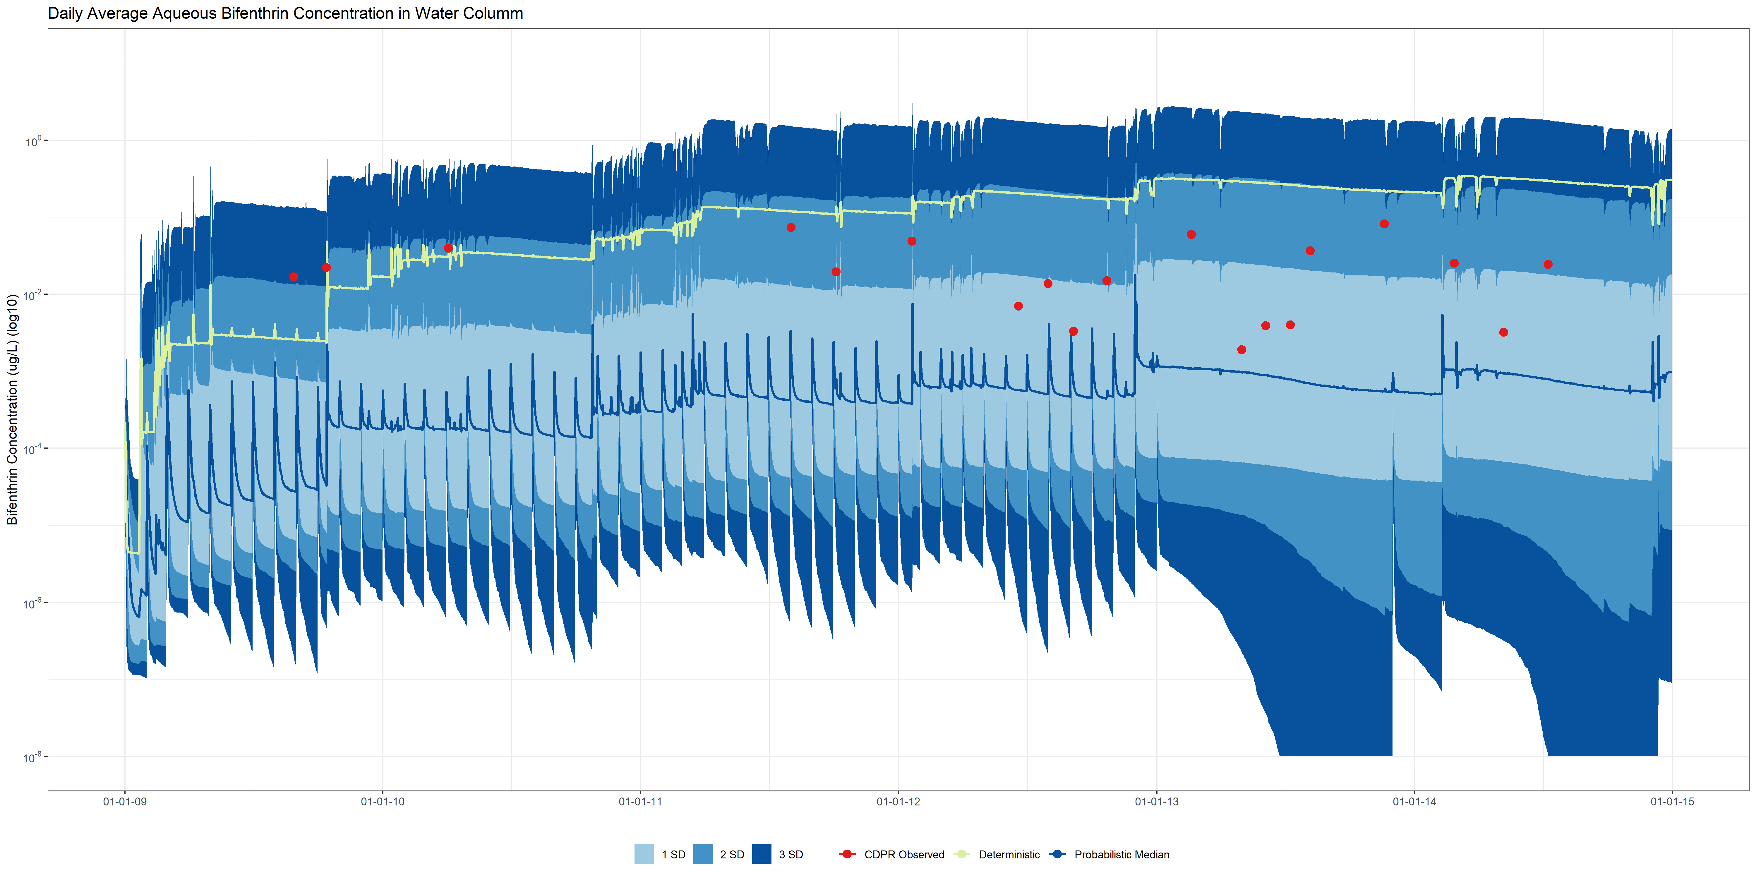
Results
FOL002

Slide 12
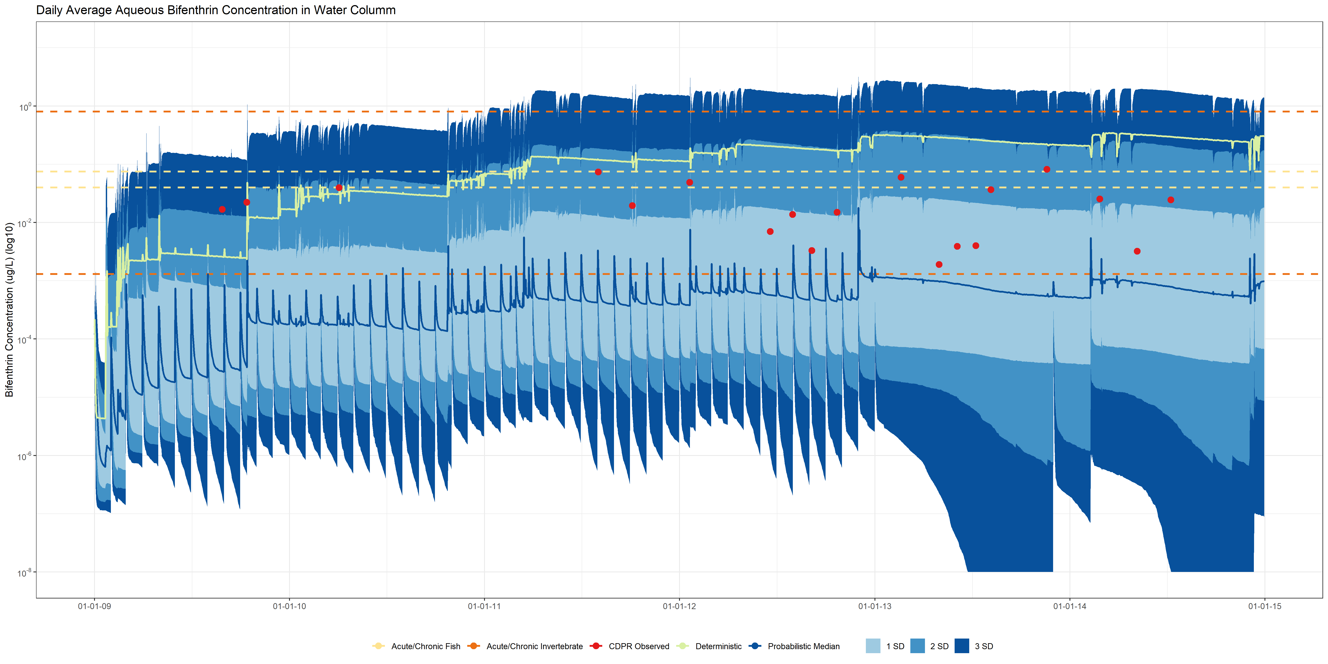
Results
FOL002

Slide 13
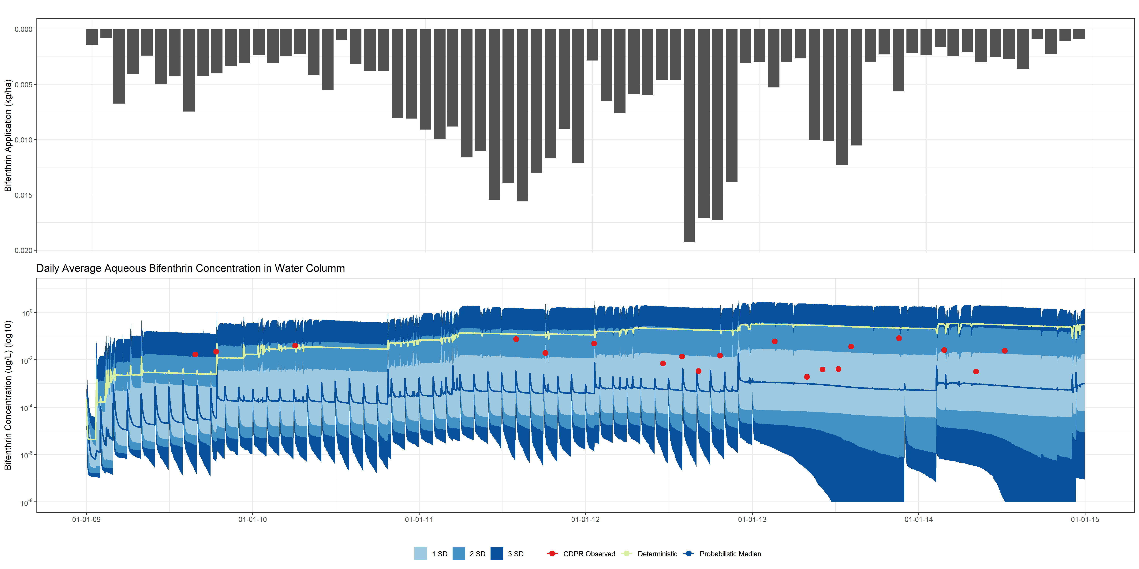
Results
FOL002

Slide 14
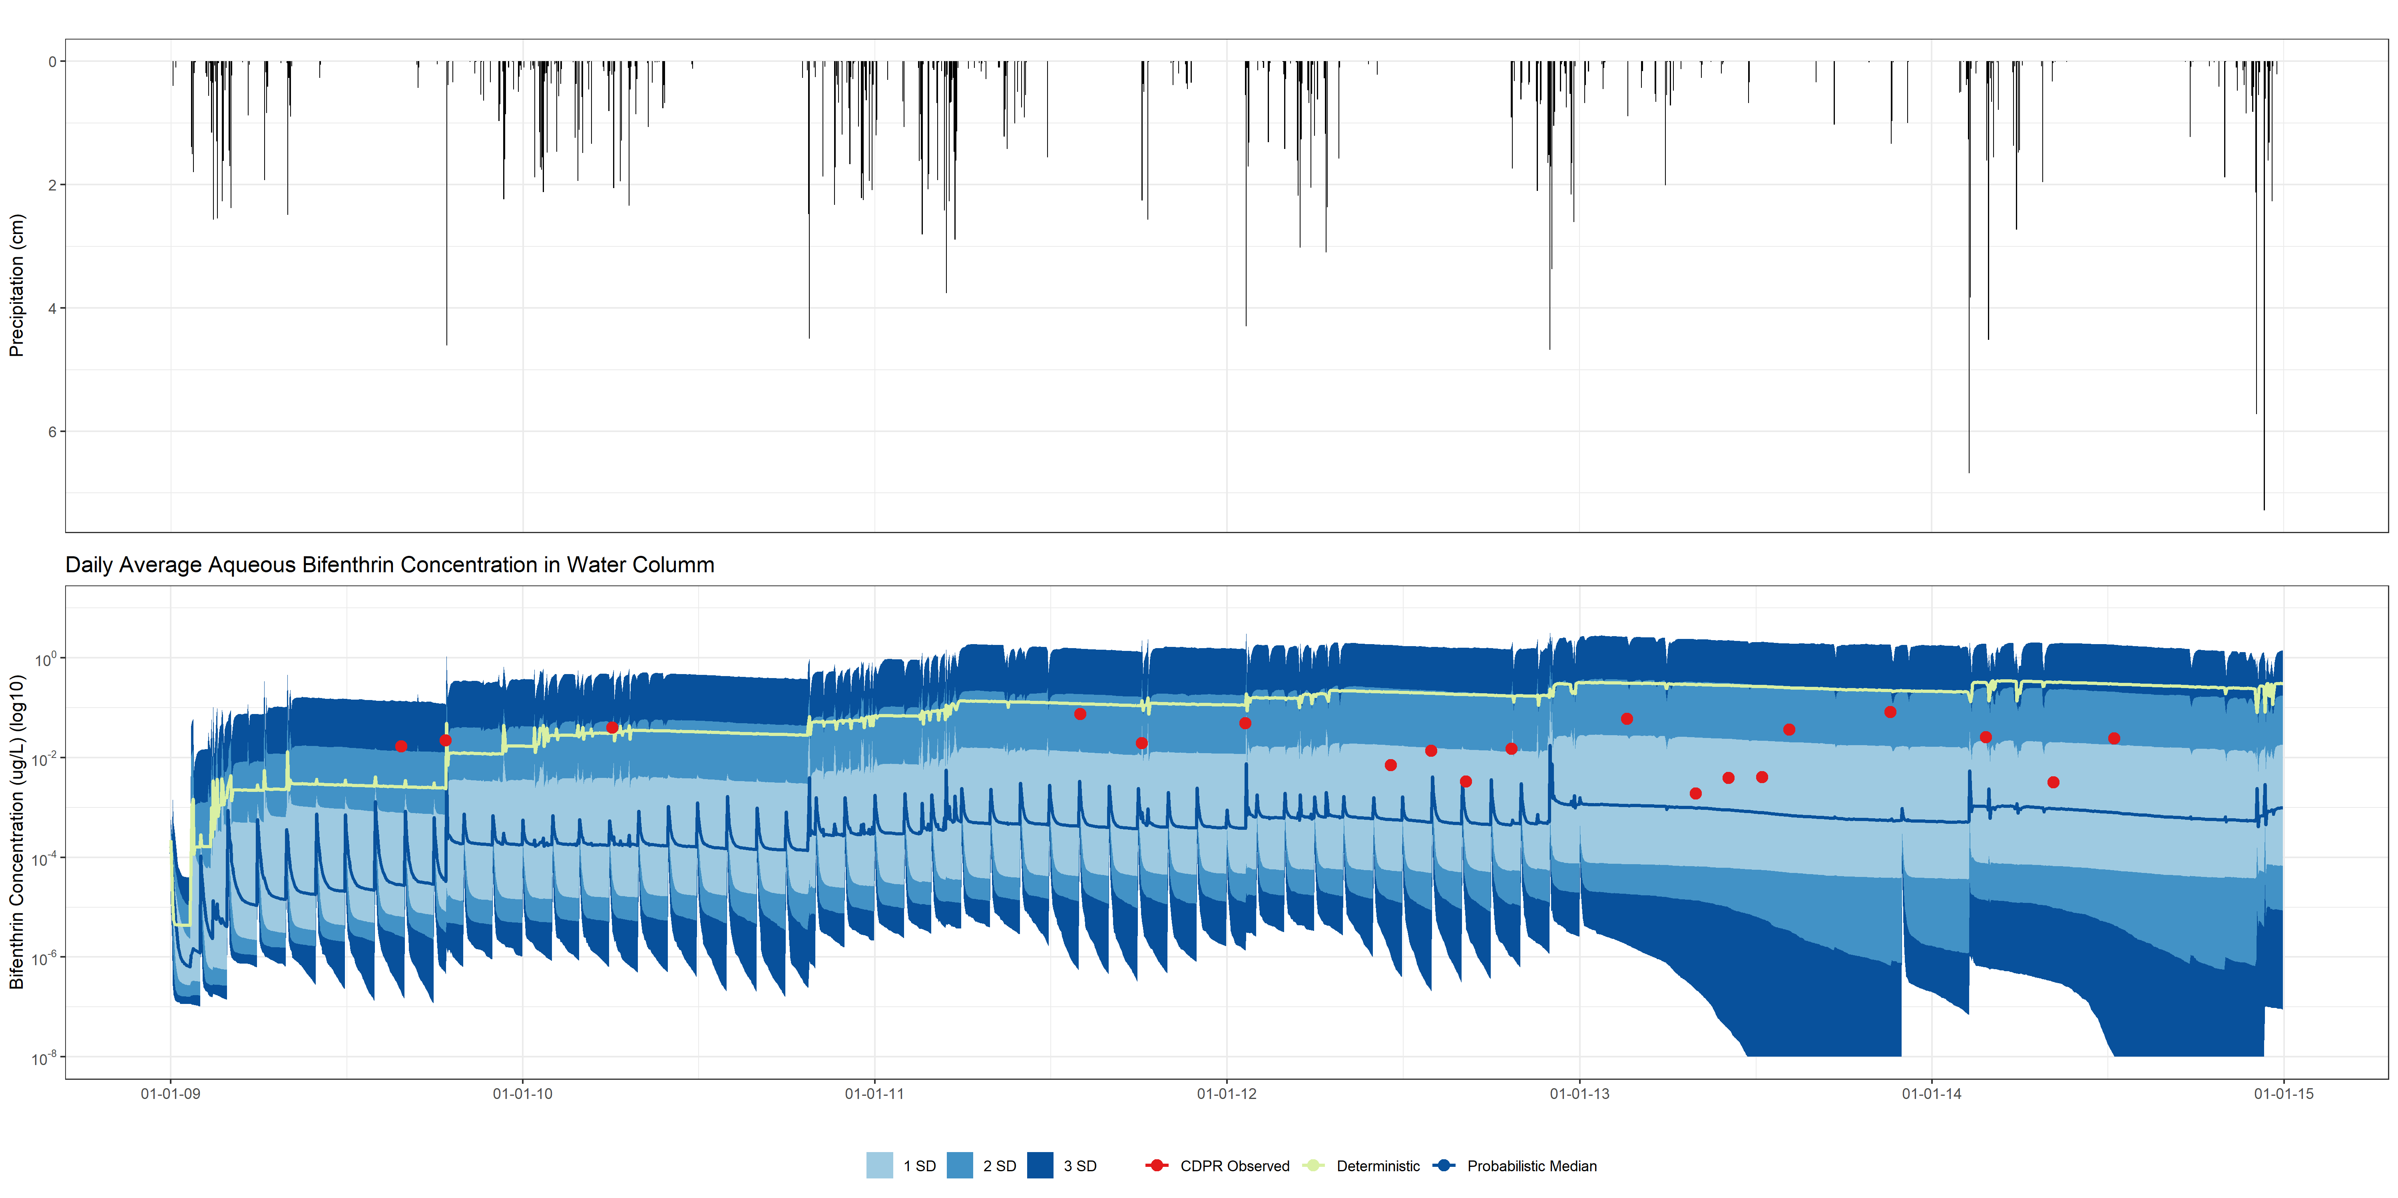
Results
FOL002

Slide 15
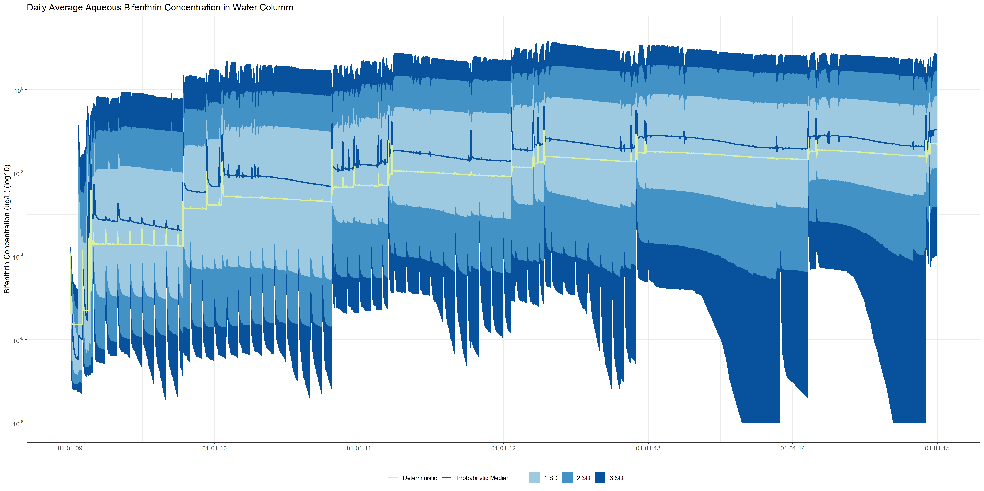
Results
PGC010

Slide 16
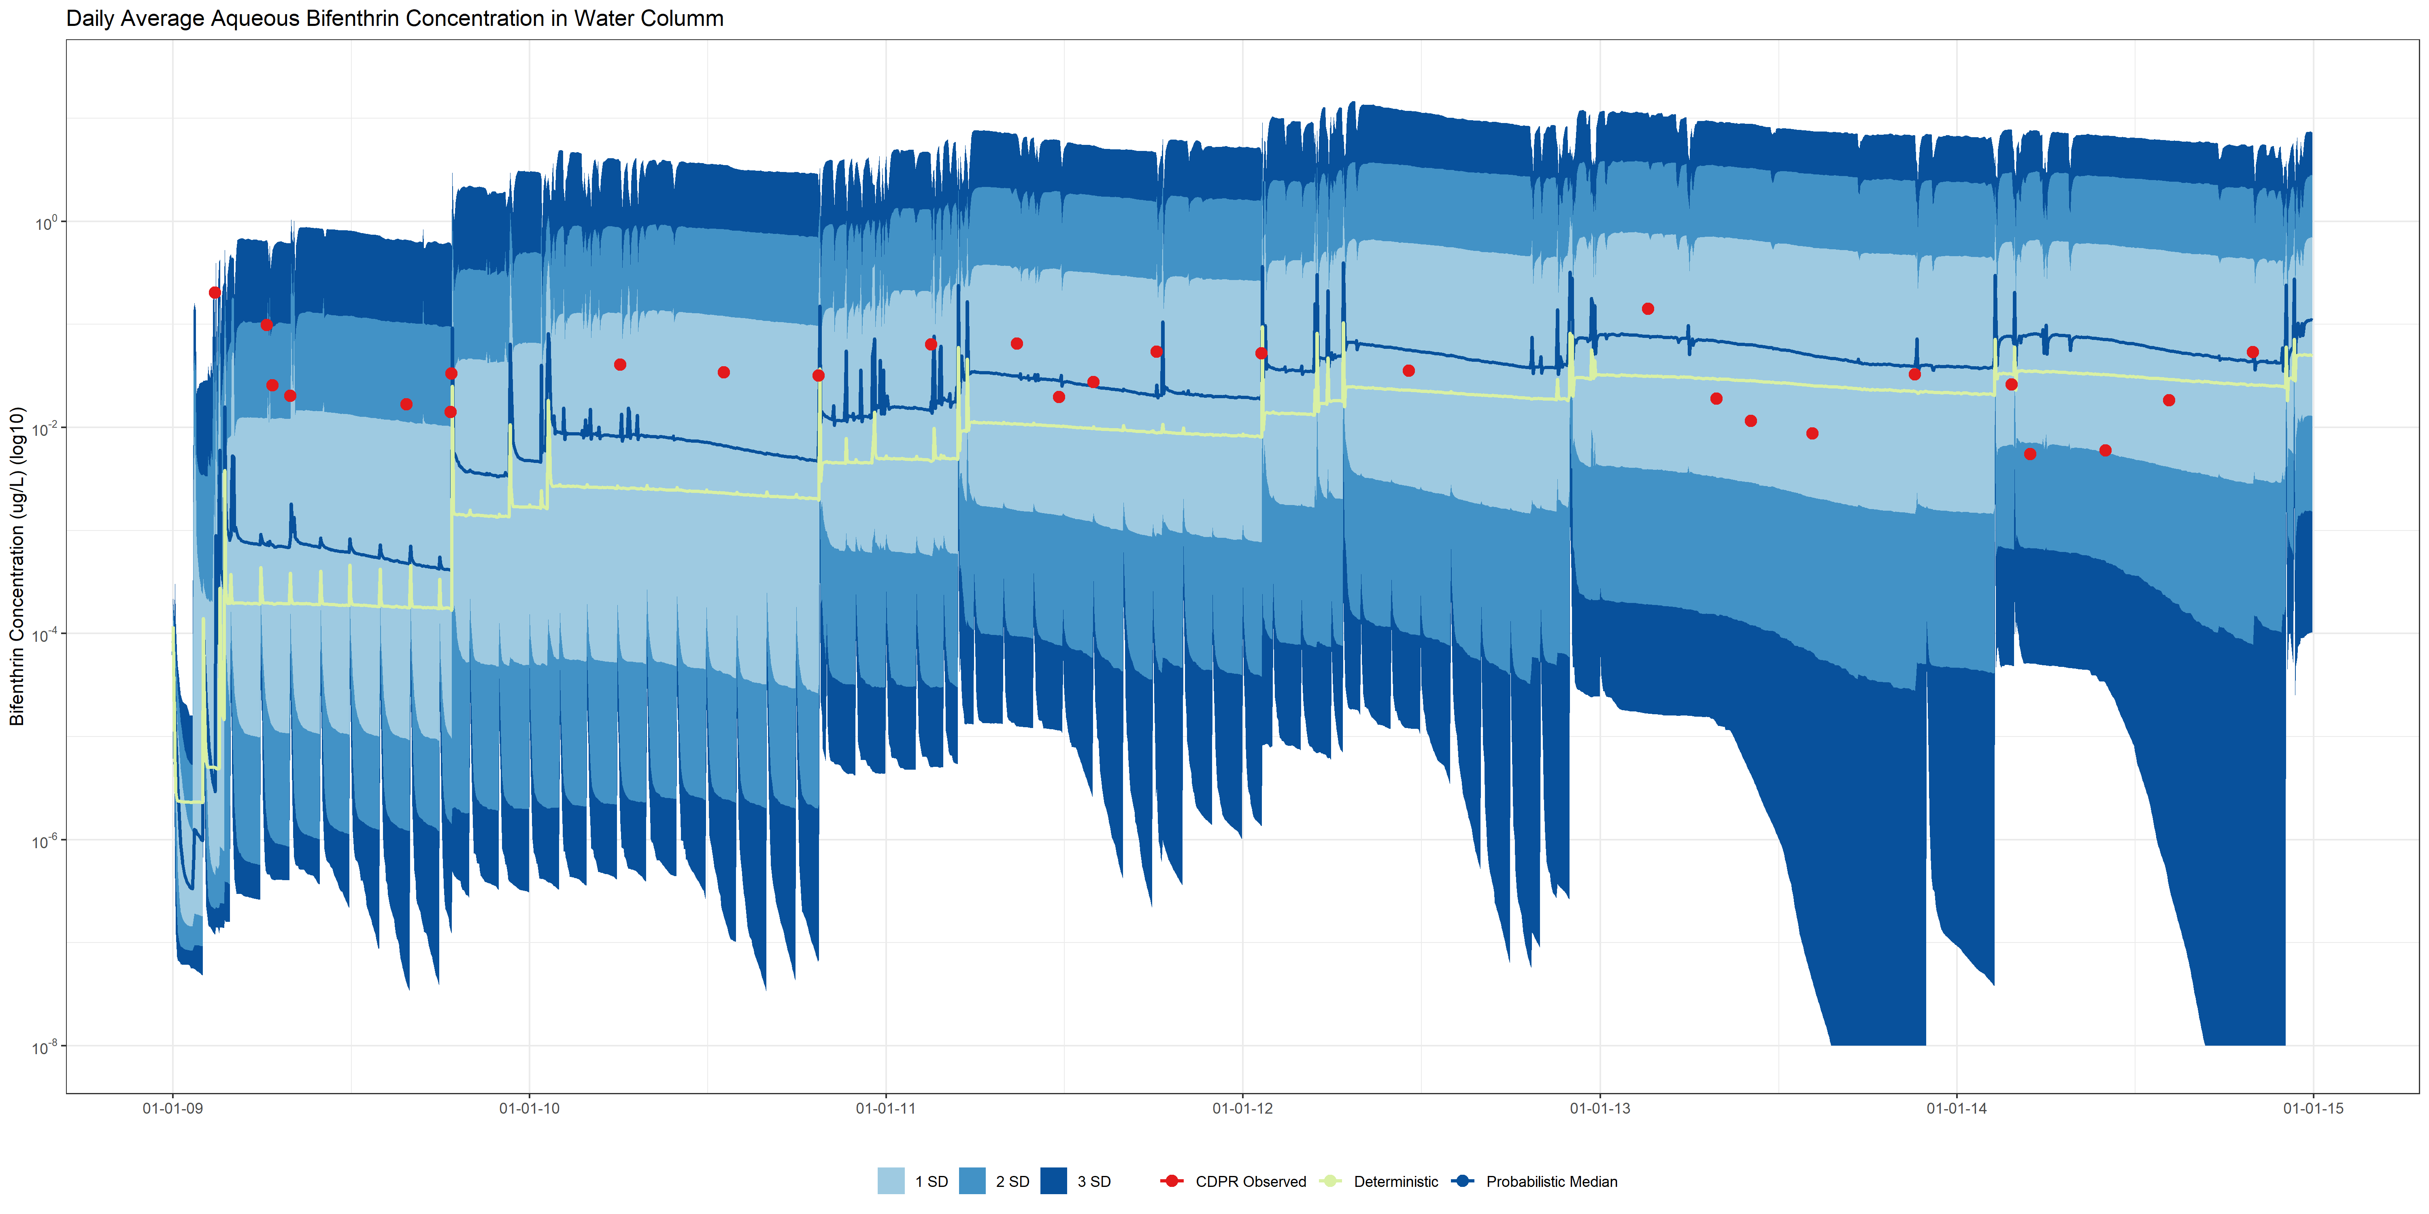
Results
PGC010

Slide 17
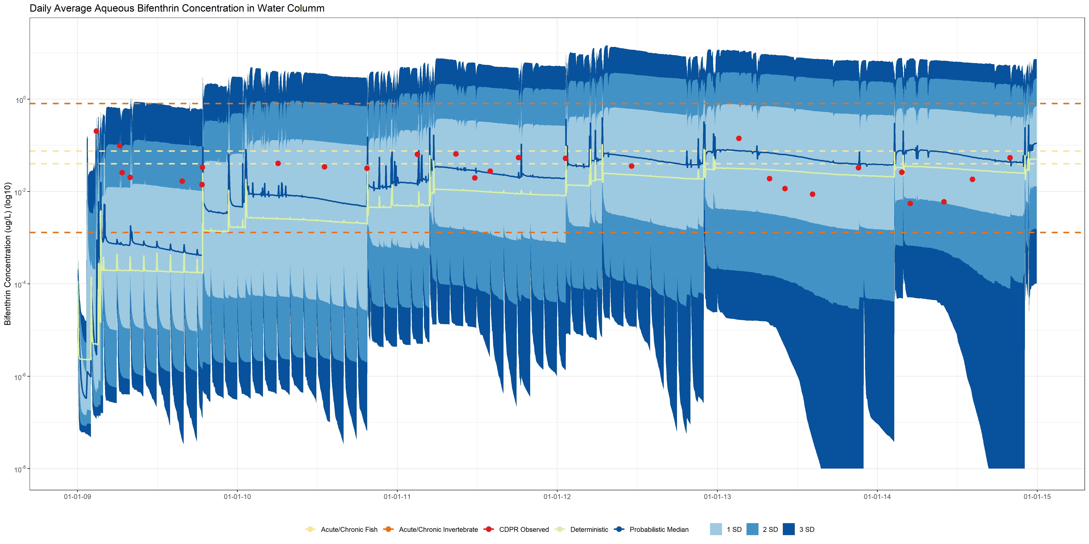
Results
PGC010

Slide 18
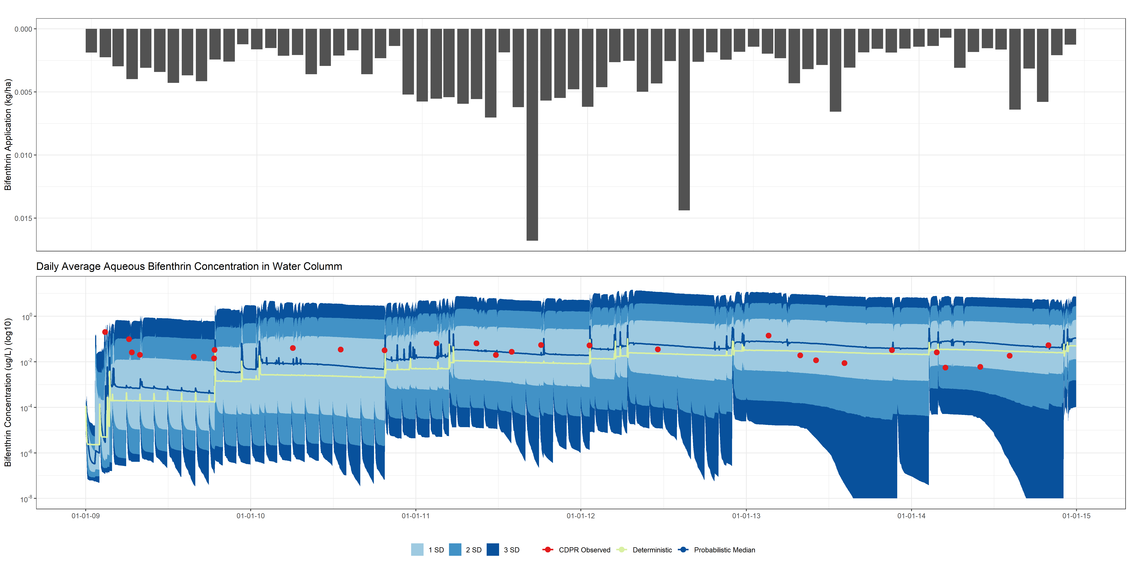
Results
PGC010

Slide 19
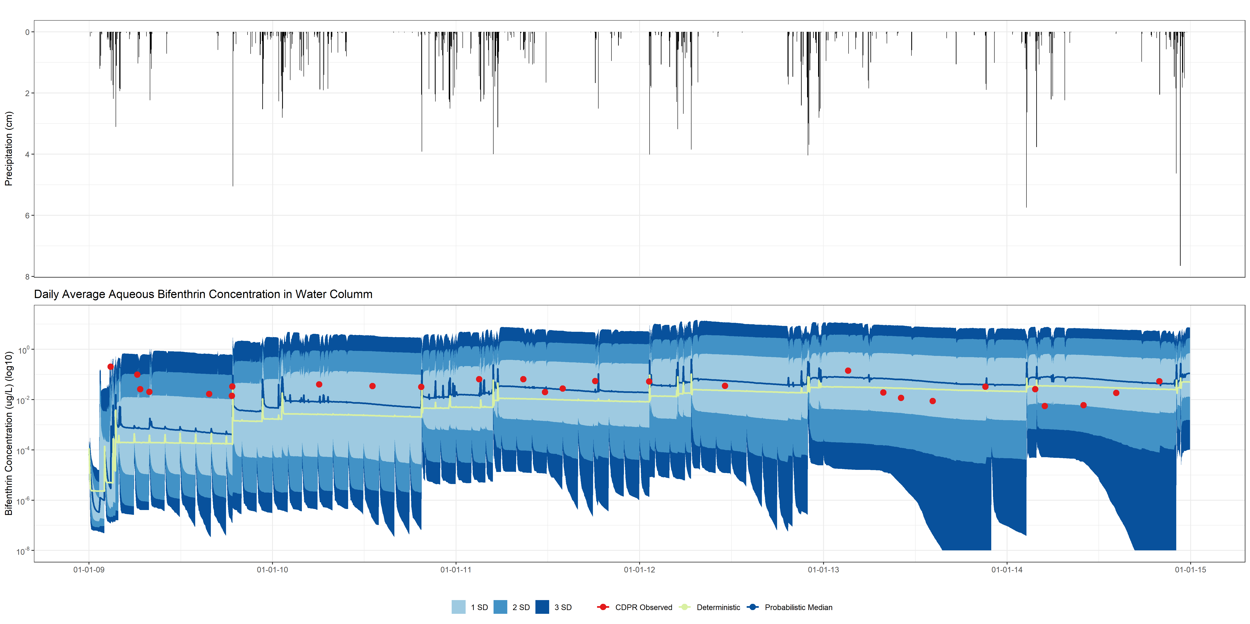
Results
PGC010

Slide 20
Percentile Plots (benthic zone)

Slide 21
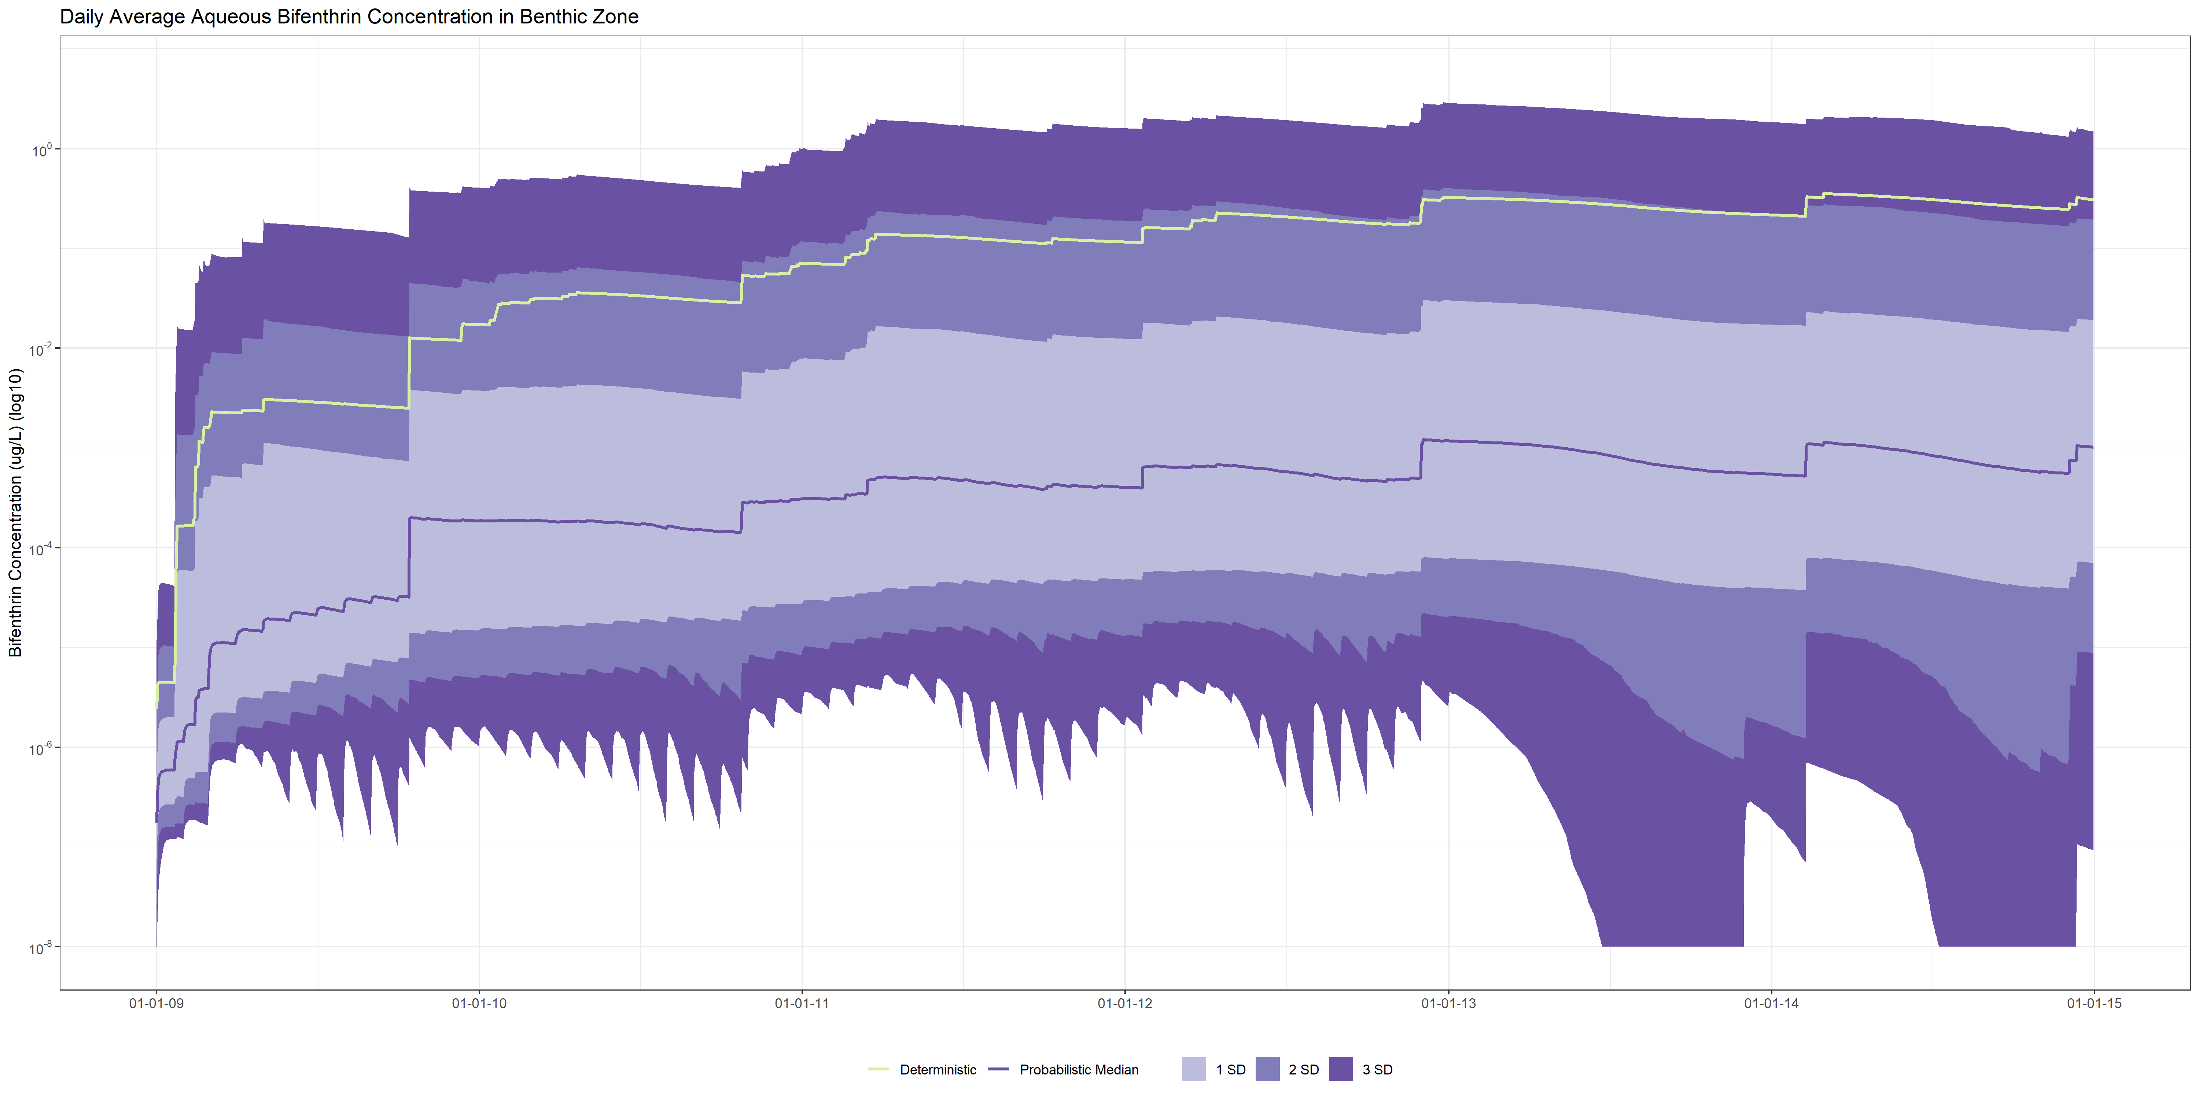
Results
FOL002

Slide 22
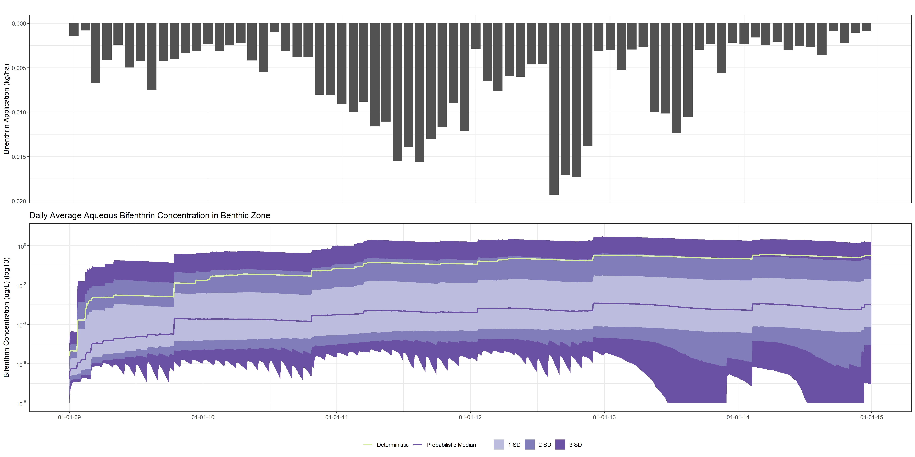
Results
FOL002

Slide 23
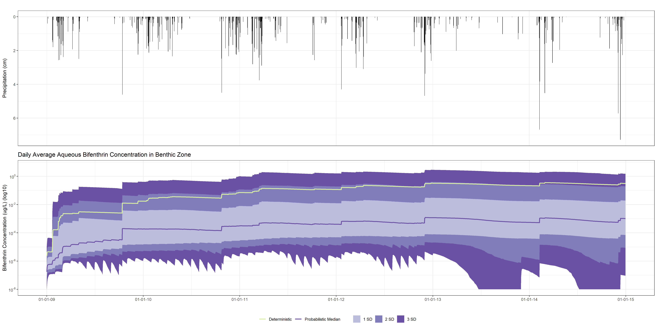
Results
FOL002

Slide 24
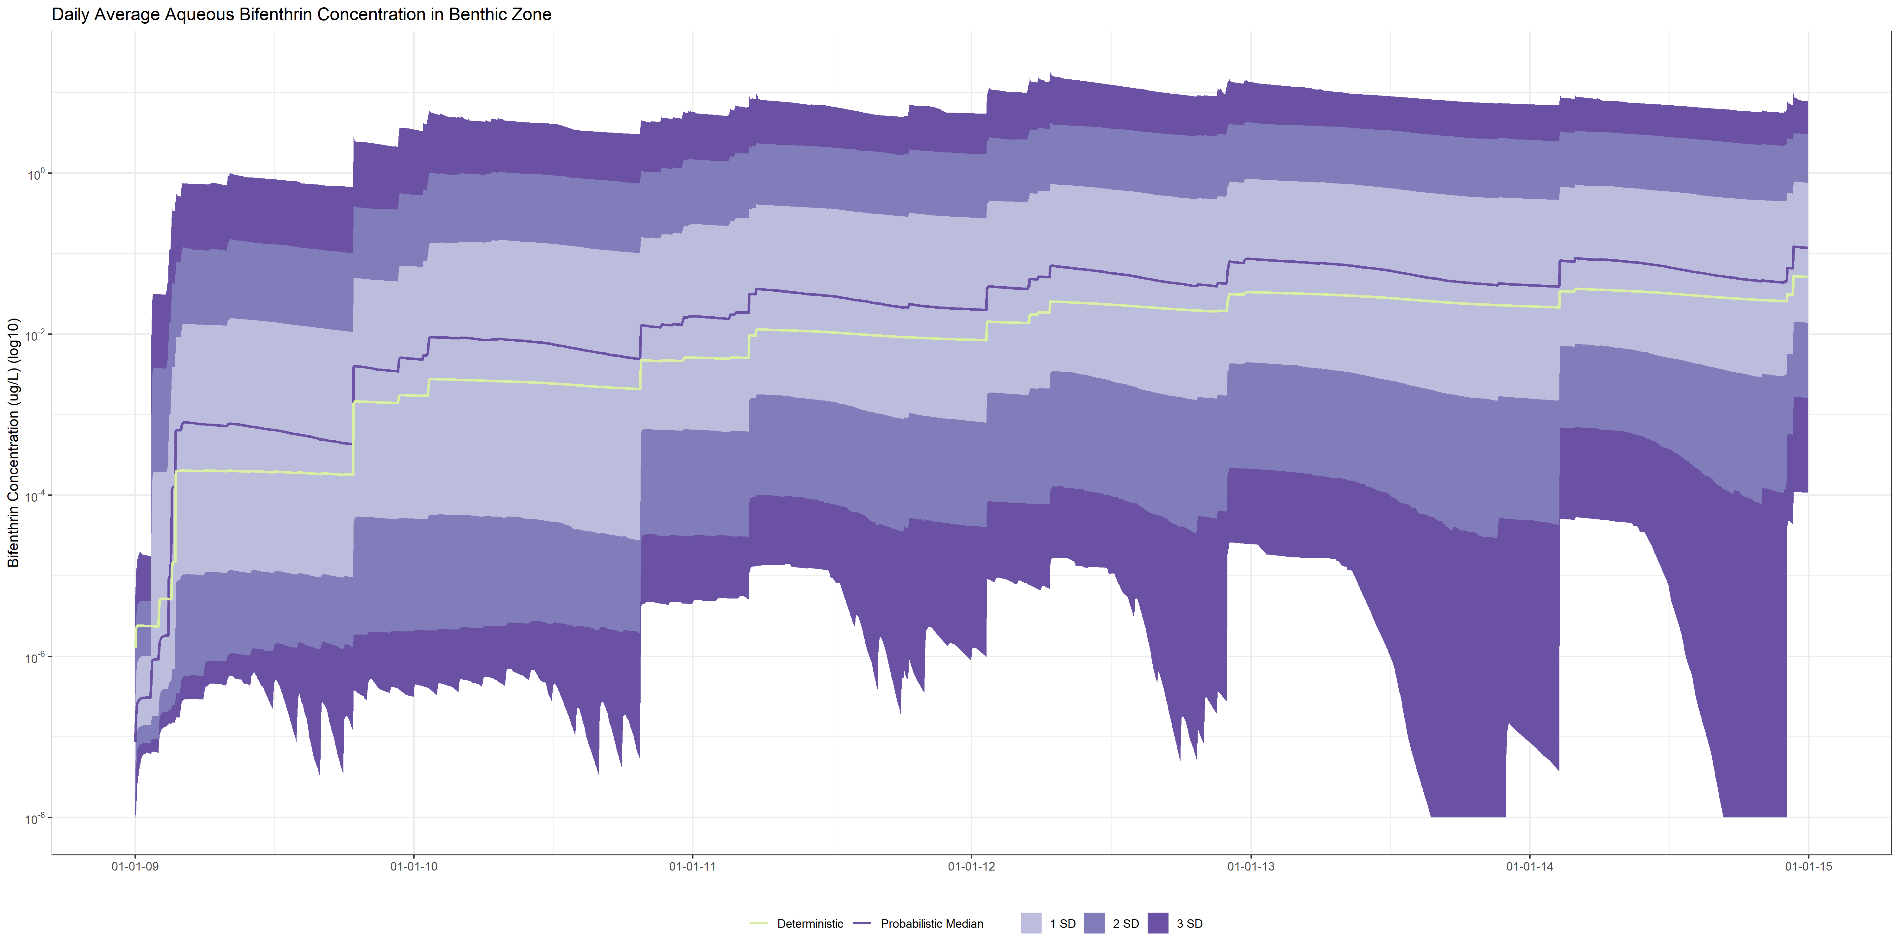
Results
PGC010

Slide 25
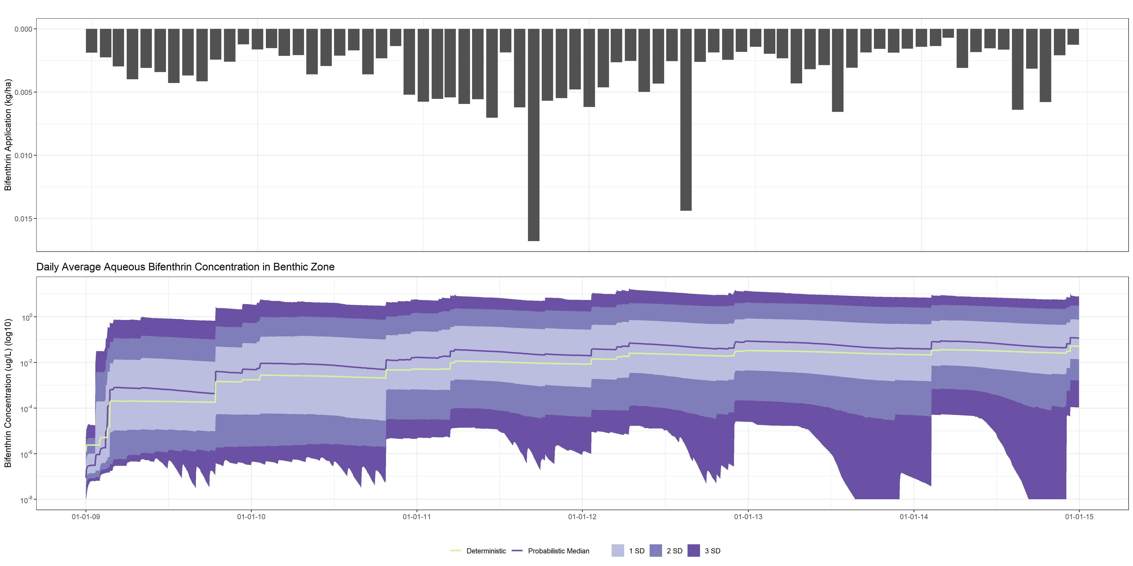
Results
PGC010

Slide 26
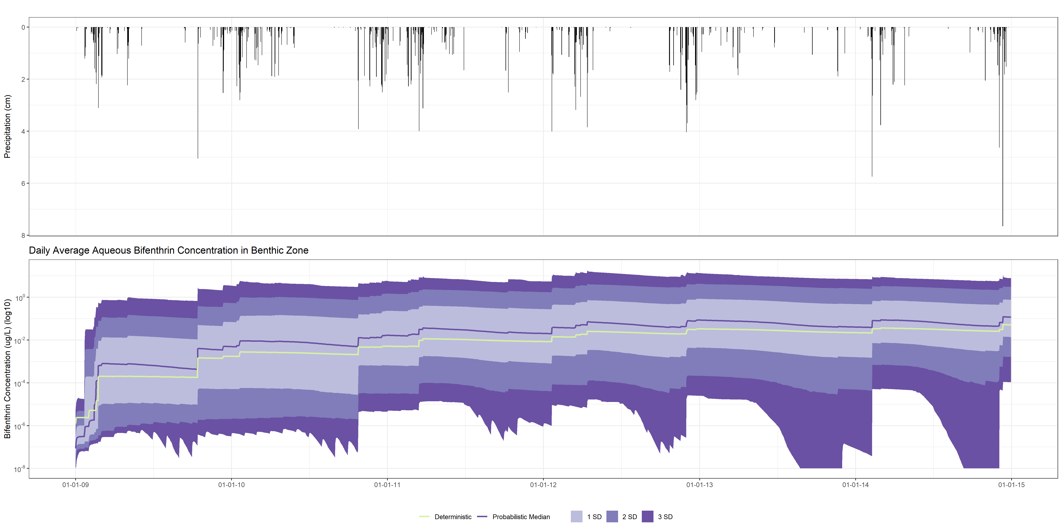
Results
PGC010

Slide 27
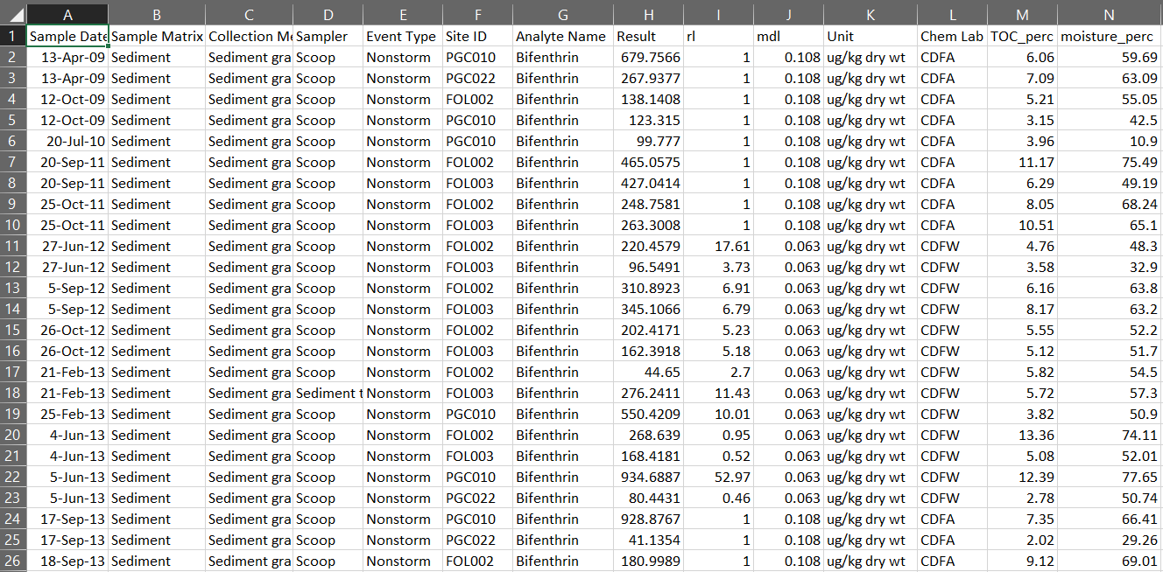

Slide 28
Partial Correlation Coefficients

Slide 29
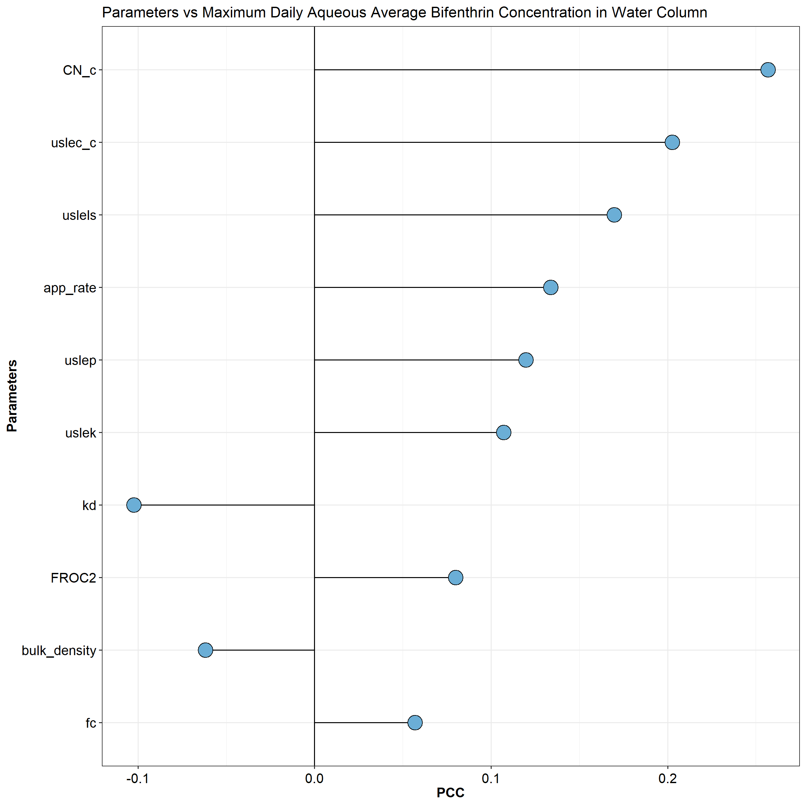
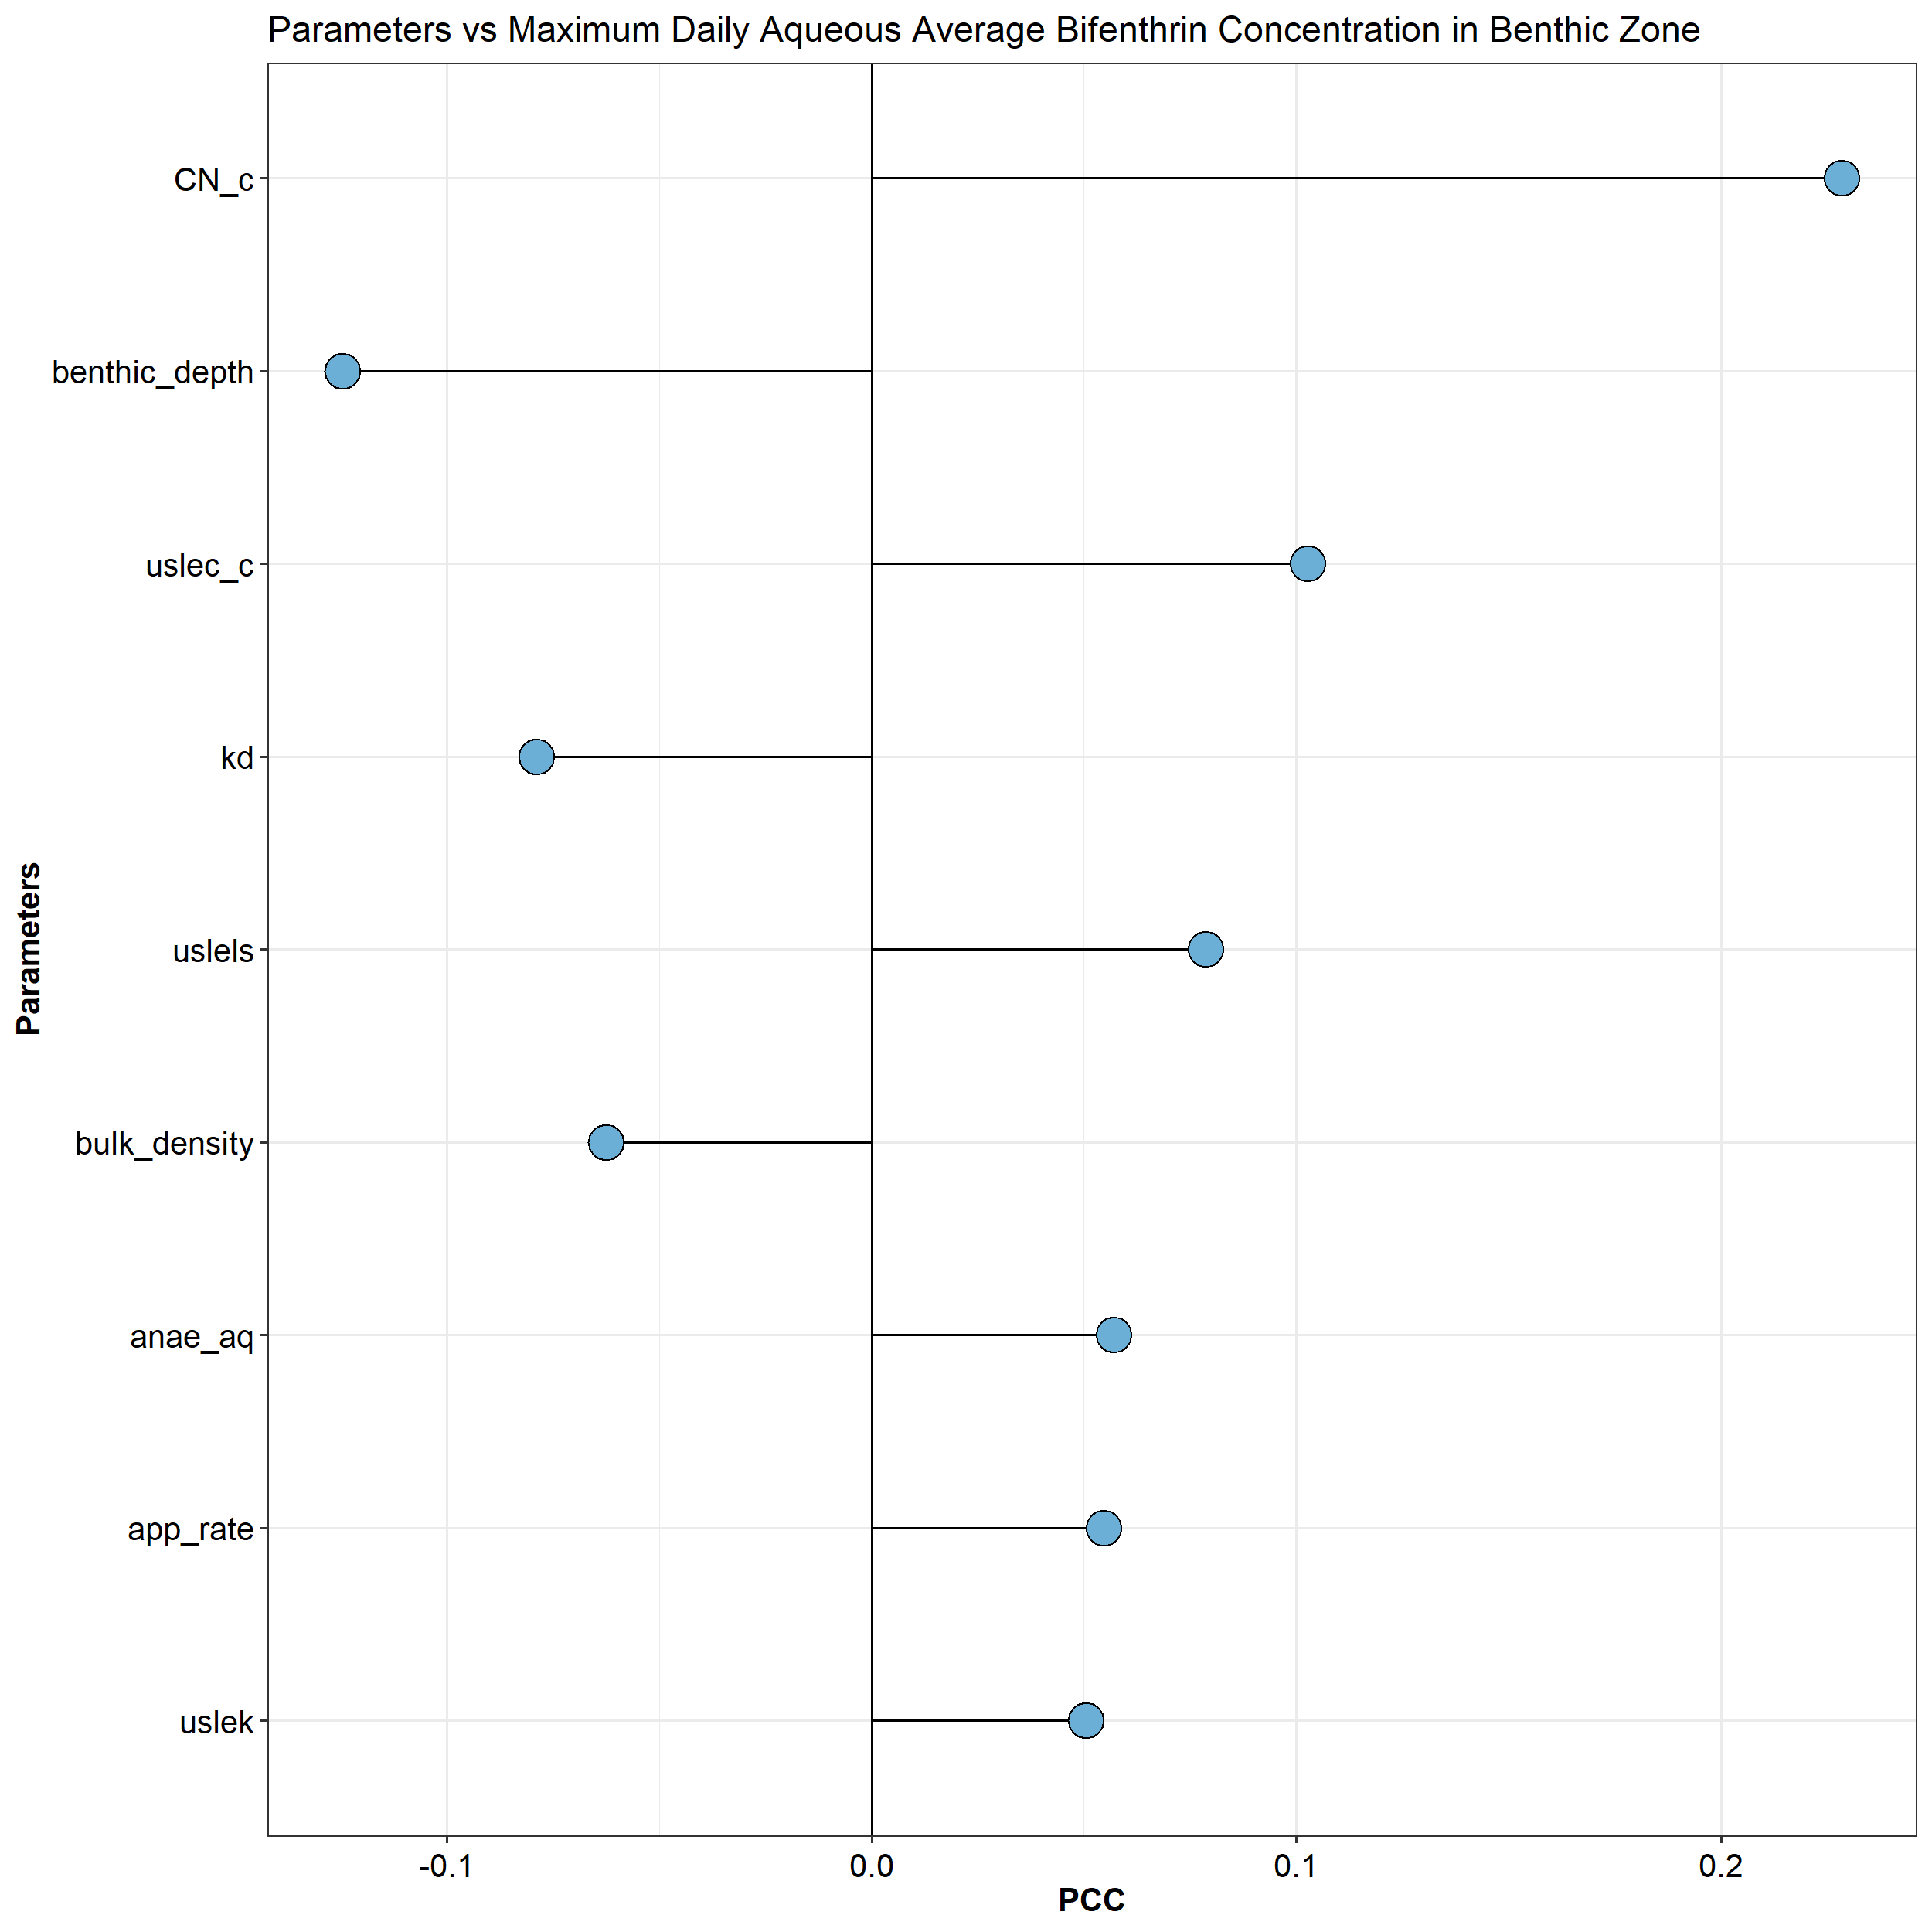
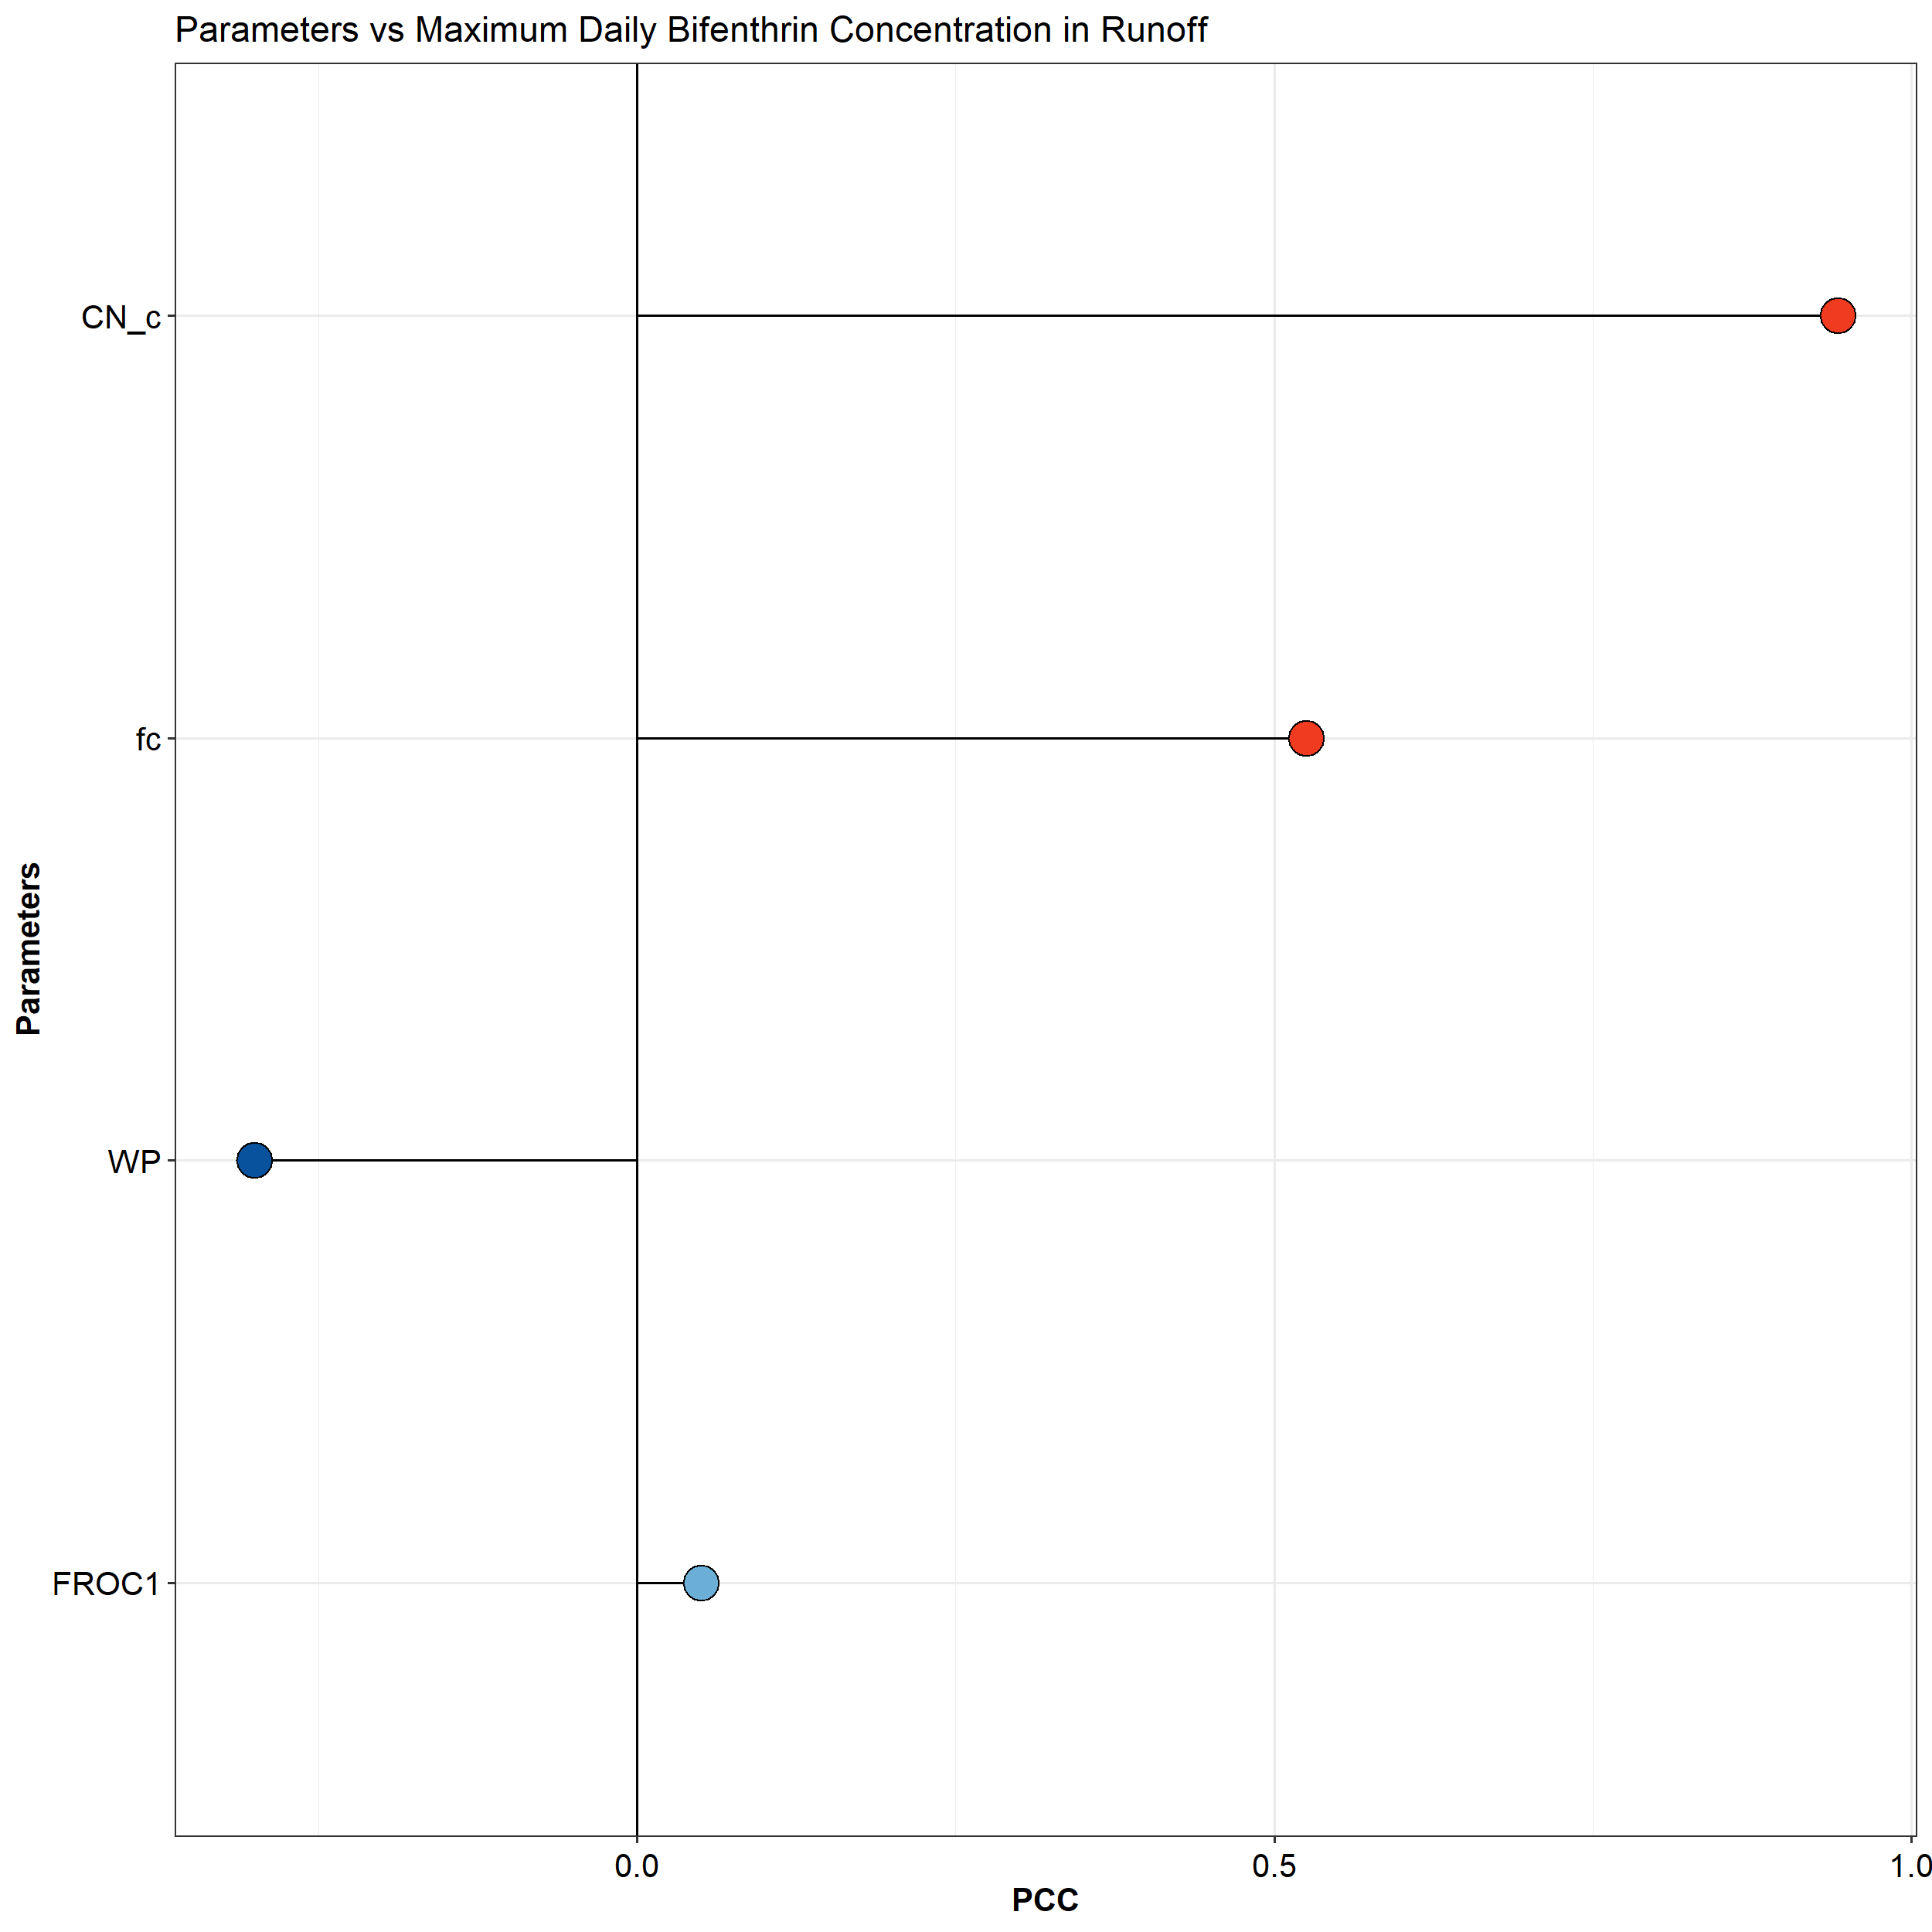
Results
FOL002
CN_c = runoff curve number
uslec_c = soil loss cover management factors
uslels = Universal Soil Loss Equation topographic factor
uslep = Universal Soil Loss Equation practice factor
uslek = Universal Soil Loss Equation (K) of soil erodibility
app_rate = application rate (kg/ha)
FROC1 = fraction of organic carbon on sediment in water column
FROC2 = fraction of organic carbon on sediment in benthic region
kd = dissociation constant (mL/g)
benthic_depth = depth of benthic region (m)
bf = provides additional constant flow through water body
bulk_density = bulk density of benthic region (g/mL)
anae_aq = benthic degradation half life (days)
fc = field capacity in the horizon (cm3 cm-3)
WP = wilting point in the horizon (cm3 cm-3)

Slide 30
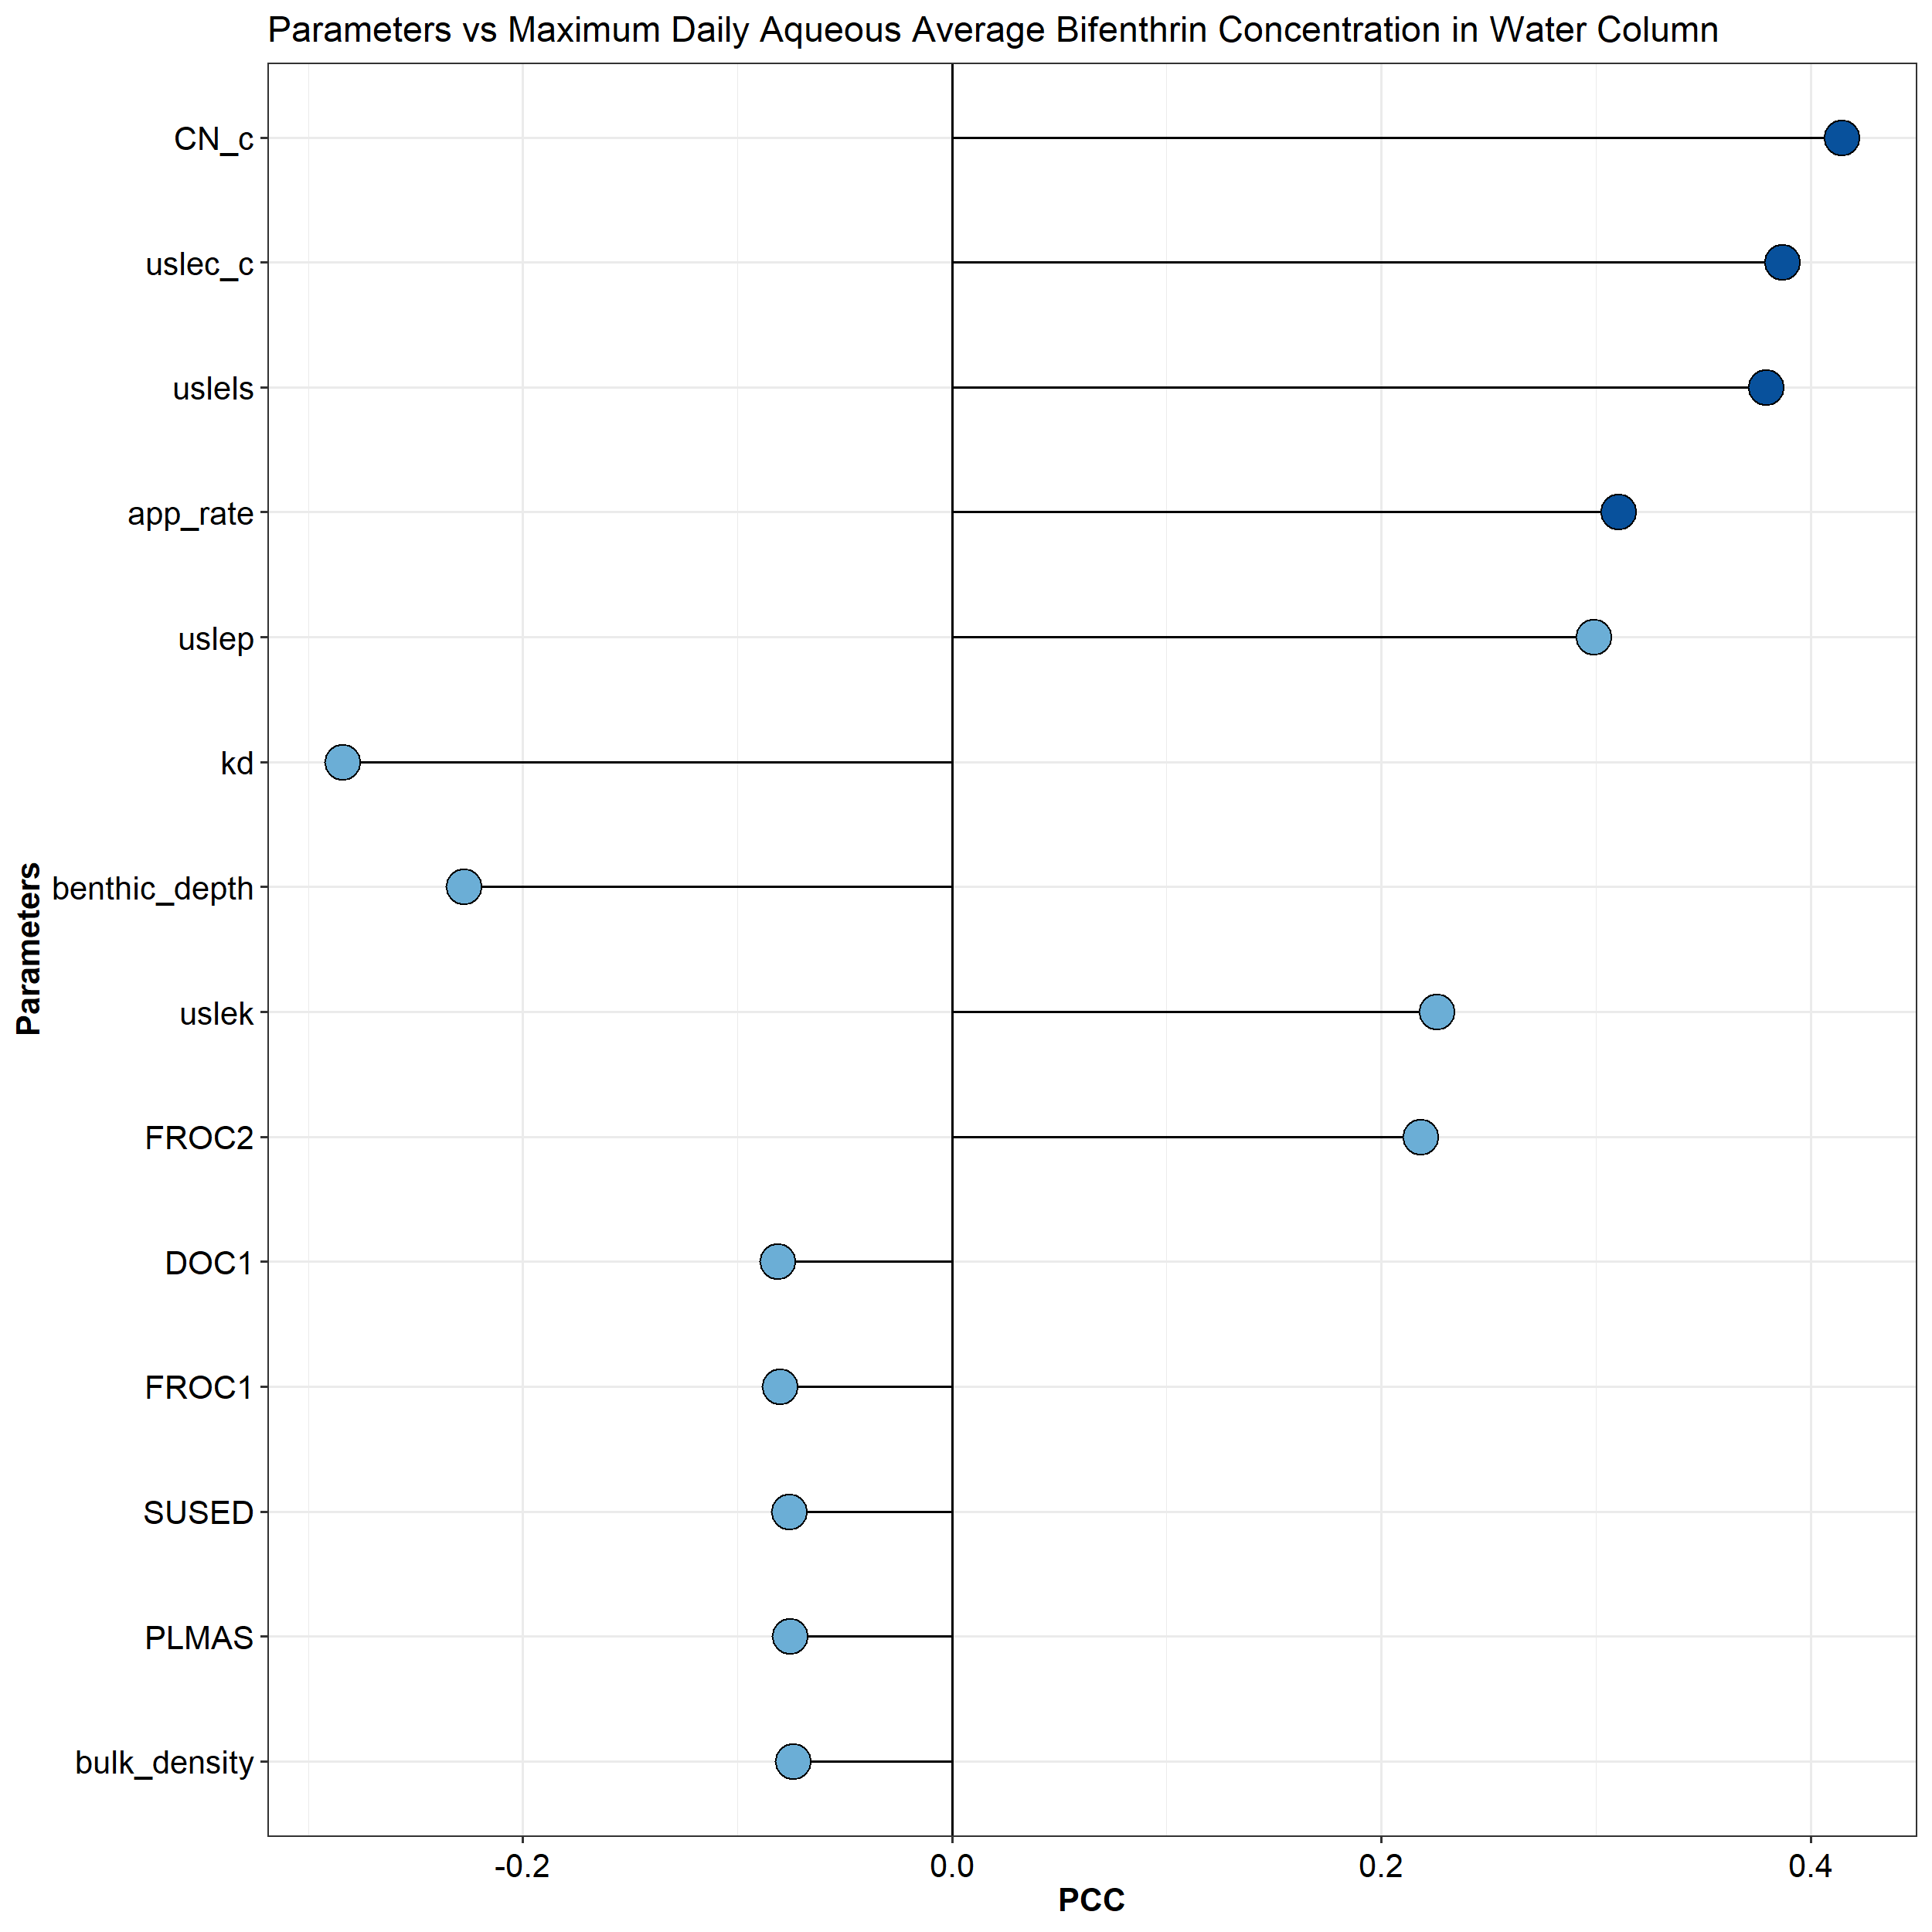
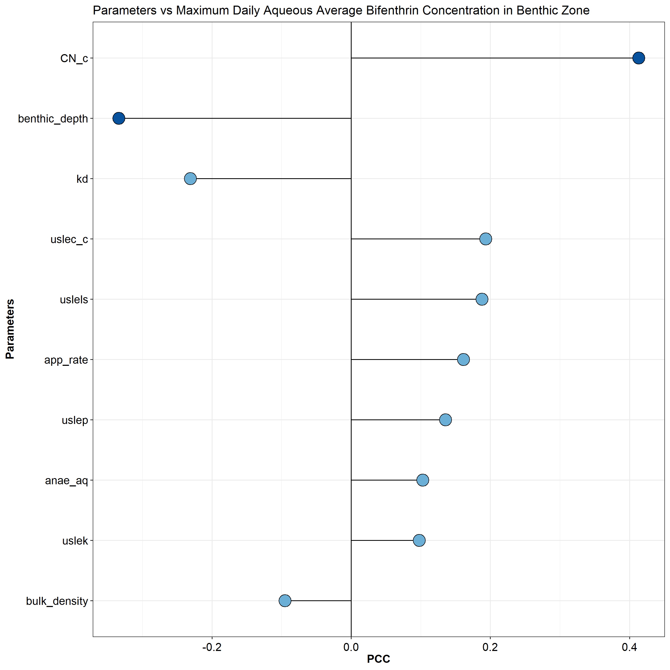
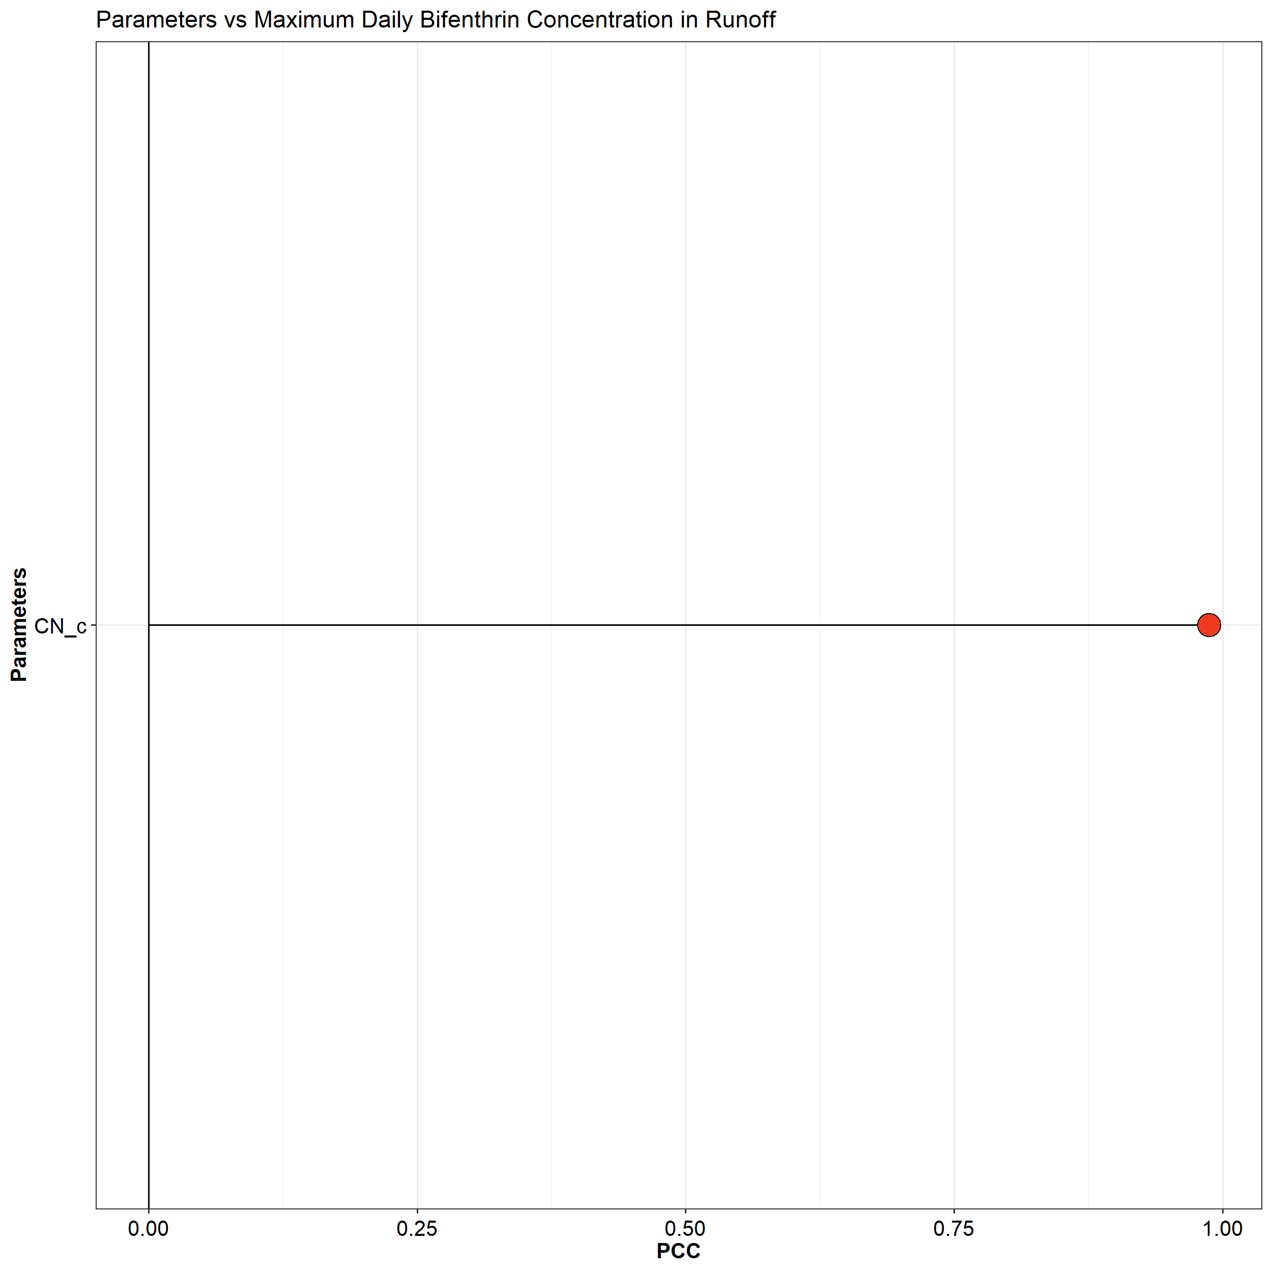
Results
PGC010
CN_c = runoff curve number
uslec_c = soil loss cover management factors
uslels = Universal Soil Loss Equation topographic factor
app_rate = application rate (kg/ha)
uslep = Universal Soil Loss Equation practice factor
kd = dissociation constant (mL/g)
uslek = Universal Soil Loss Equation (K) of soil erodibility
benthic_depth = depth of benthic region (m)
FROC2 = fraction of organic carbon on sediment in benthic region
FROC1 = fraction of organic carbon on suspended sediment in water column
DOC1 = concentration of dissolved organic carbon in water column (mg/L)
SUSED = suspended solids concentration in water column (mg/L)
PLMAS = concentration of biosolids in water column (mg/L)
anae_aq = benthic degradation half-life (days)
bulk_density = bulk density of benthic region (g/mL)

Slide 31
The End
Questions?

Slide 33
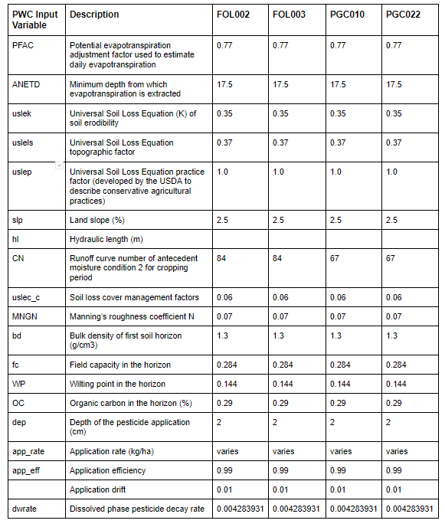
Deterministic Input Parameters

Slide 34
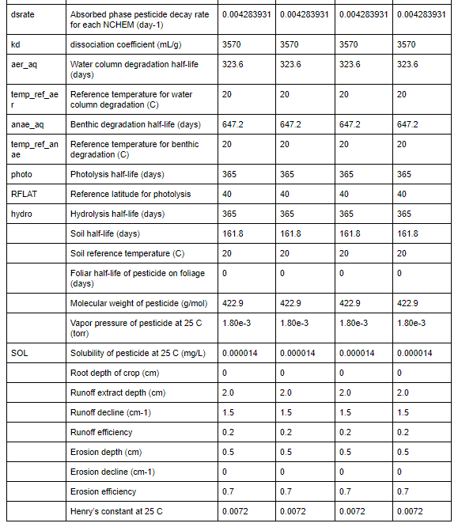
Deterministic Input Parameters

Slide 35
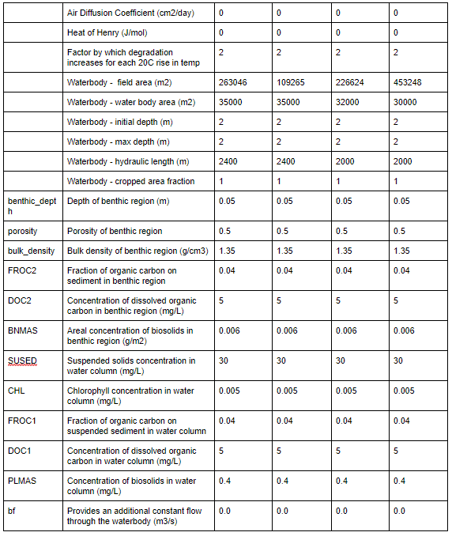
Deterministic Input Parameters

Slide 36
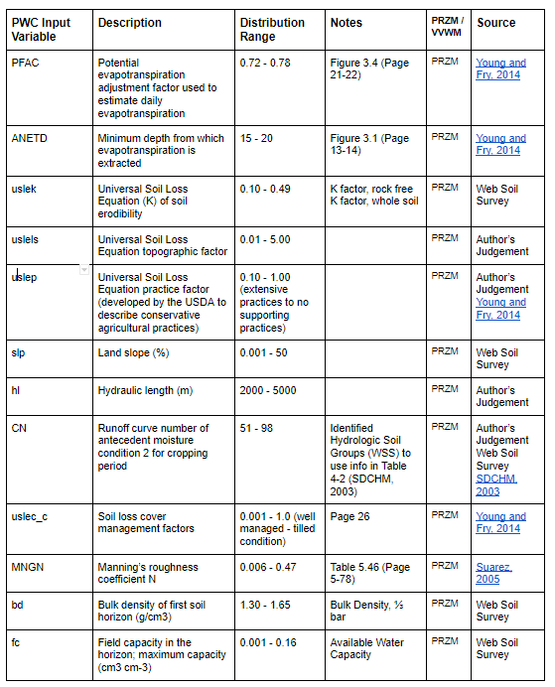
Probabilistic Input Ranges

Slide 37
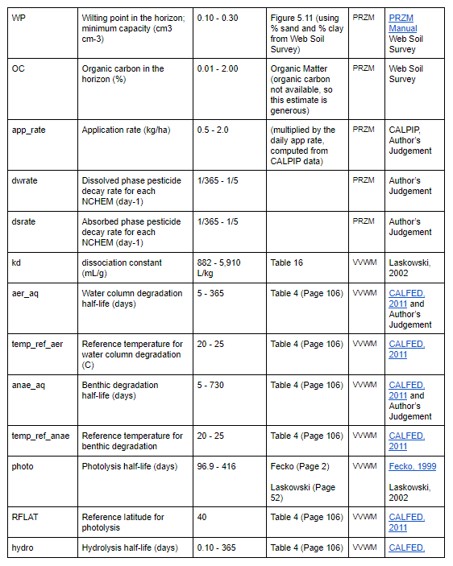
Probabilistic Input Ranges

Slide 38
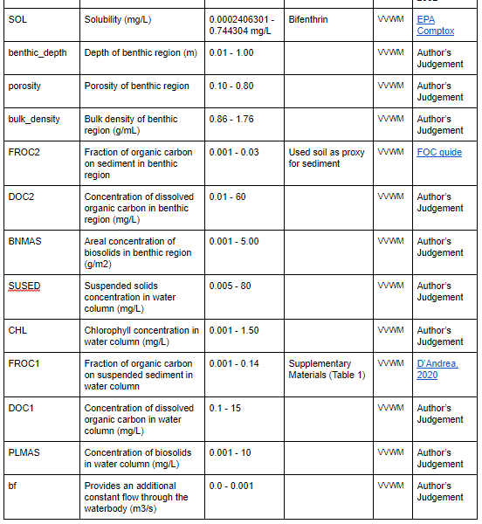
Probabilistic Input Ranges

Slide 39
Application Rates Computation
Folsom Watershed
County | Sub-County District | Area of Sub-County (mi2) | Pop Density (people/mi2) [1] | Area of Watershed intersecting County (mi2) [2] (%) |  | Population in watershed [1]*[2]
Sacramento | Folsom | 27.61 | 73356 / 27.61 = 2656.86 | 26.21 | 47.44 | 69637
 | Rancho Cordova | 69.70 | 114151 / 69.70 = 1637.75 | 14.46 | 26.17 | 23682
 | Sacramento | 375.67 | 1097102 / 375.67 = 2920.39 | 9.64 | 17.45 | 28153
 | Sloughhouse | 123.09 | 7044 /123.09 = 57.23 | 2.44 | 4.42 | 140
Subtotal |  |  |  |  |  | 121612
El Dorado | South El Dorado | 765.83 | 105175 / 765.83 = 137.33 | 2.36 | 4.27 | 325
Subtotal |  |  |  |  |  | 325
Placer | Rocklin | 72.72 | 88195 /72.72 = 1212.80 | 0.13 | 0.24 | 158
Subtotal |  |  |  |  |  | 158
Total |  |  |  | 55.25 | 100.00 | 122095
County | Total Population in County [3] | Population in the watershed (from above table) [4] | Fraction (%) [4]/[3]
Sacramento | 1450277 | 121612 | 8.39
El Dorado | 181465 | 325 | 0.18
Placer | 361518 | 158 | 0.04
[8.39% * PUR(Sacramento County)] +
[0.18% * PUR(El Dorado County)] +
[0.04% * PUR(Placer County)]

Slide 40
Application Rates Computation
PGC Watershed
County | Sub-County District | Area of Sub-County (mi2) | Pop Density (people/mi2) [1] | Area of Watershed intersecting County (mi2) [2] (%) |  | Population in watershed [1]*[2]
Placer | Lincoln | 211.75 | 73015 / 211.75 = 344.82 | 23.19 | 49.46 | 7997
 | Roseville | 37.78 | 117209 / 37.78 = 3102.41 | 15.61 | 33.29 | 48429
 | Rocklin | 72.72 | 88195 / 72.72 = 1212.80 | 6.74 | 14.38 | 8175
Subtotal |  |  |  | 45.54 | 97.13 | 64601
Sutter | South Sutter | 131.96 | 2570 /131.96 = 19.48 | 1.35 | 2.88 | 27
 |  |  |  | 1.35 | 2.88 | 27
Total |  |  |  | 46.89 | 100.00 | 646280
County | Total Population in County [3] | Population in the watershed (from above table) [4] | Fraction (%) [4]/[3]
Placer | 361518 | 64601 | 17.87
Sutter | 95067 | 27 | 0.03
[17.87% * PUR(Placer County)] + [0.03% * PUR(Sutter County)]

Slide 41
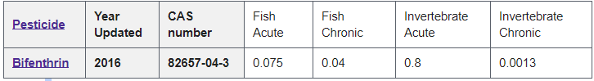
Aquatic Life Benchmarks
Source Link:
https://www.epa.gov/pesticide-science-and-assessing-pesticide-risks/aquatic-life-benchmarks-and-ecological-risk#ref_3

